Slide 1


Slide 2

PREFACE
ABOUT THE BOOK
This book contains 100 very important Angular interview questions.
ABOUT THE AUTHOR
Happy Rawat has around 15 years of experience in software development. He helps candidates in clearing technical interview in tech companies.

Slide 3

Chapters
Basics
1. Angular Framework
2. Components & Modules
3. Data Binding
4. Directives
5. Decorator & Pipes
6. Services & DI
7. Component Lifecycle-Hooks
Advanced
9. Observable\ HttpClient\ RxJS
10. Typescript-Basics
11.Typescript - OOPS
12. Angular Forms
13. Authentication
14. Components Communication
8. Routing

Slide 4
Table of Contents
Chapter 1: Angular Framework
Q1. What is Angular?
Q2. What are Angular advantages?
Q3. What is the difference between AngularJS and Angular?
Q4. What is NPM?
Q5. What is CLI tool?
Q6. What is Typescript? What are the advantages of Typescript over Javascript?
Q7. Where to store static files in Angular project?
Q8. What is the role of Angular.json file in Angular?
Q9. What is the difference between JIT and AOT in Angular?
Chapter 2: Components & Modules
Q10. What are Components in Angular?
Q11. What is a Selector and Template?
Q12. What is Module in Angular? What is app.module.ts file?
Q13. How an Angular App gets Loaded and Started? What are index.html, app-root, selector and main.ts?
Q14. What is a Bootstrapped Module & Bootstrapped Component?

Slide 5
Chapter 3: Data Binding
Q15. What is Data Binding in Angular?
Q16. What is String Interpolation in Angular?
Q17. What is Property Binding in Angular?
Q18. What is Event Binding in Angular?
Q19. What is Two way Binding in Angular?
Chapter 4: Directives
Q20. What are Directives? What are the type of directives?
Q21. What is *ngIf Structural directive?
Q22. What is *ngFor Structural directive?
Q23. What is *ngSwitch Structural directive?
Q24. What is [ngStyle] Attribute directive?
Q25. What is [ngClass] Attribute directive?
Q26. What is the difference between Component, Attribute and Structural Directives?

Slide 6
Chapter 5: Decorator & Pipes
Q27. What is Decorator?
Q28. What are the types of Decorator?
Q29. What are Pipes? What are the types of Pipes & Parameterized Pipes?
Q30. What is Chaining Pipes?
Chapter 6: Services & Dependency Injection
Q31. Explain Services with Example?
Q32. How to create Service in Angular?
Q33. How to use Dependency Injector with Services in Angular?
Q34. What is Hierarchical Dependency Injection?
Q35. What is Provider in Angular?
Q36. What is the role of @Injectable Decorator in a Service?

Slide 7
Chapter 7: Decorators & Lifecycle-Hooks
Q37. What are Parent-Child Components?
Q38. What is @Input Decorator? How to transfer data from Parent component to Child component?
Q39. What is @Output Decorator and Event Emitter?
Q40. What are Lifecycle Hooks in Angular?
Q41. What is a Constructor in Angular?
Q42. What is ngOnChanges life cycle hook in Angular?
Q43. What is ngOnInit life cycle hook in Angular?
Q44. What is the difference between constructor and ngOnInit?
Chapter 8: Routing
Q45. What is Routing? How to setup Routing?
Q46. What is router outlet?
Q47. What are router links?

Slide 8
Chapter 9: Observable\ HttpClient\ RxJS
Q48. What are Asynchronous operations?
Q49. What is the difference between Promise and Observable?
Q50. What is RxJS?
Q51. What is Observable? How to implement Observable ?
Q52. What is the role of HttpClient in Angular?
Q53. What are the steps for fetching the data with HttpClient & Observable?
Q54. How to do HTTP Error Handling in Angular?
Chapter 10: Typescript-Basics
Q55. What is Typescript? Or What is the difference between Typescript and Javascript?
Q56. How to install Typescript and check version?
Q57. What is the difference between let and var keyword?
Q58. What is Type annotation?
Q59. What are Built in/ Primitive and User-Defined/ Non-primitive Types in Typescript?

Slide 9
Q60. What is “any” type in Typescript?
Q61. What is Enum type in Typescript?
Q62. What is the difference between void and never types in Typescript?
Q63. What is Type Assertion in Typescript?
Q64. What are Arrow Functions in Typescript?
Chapter 11: Typescript - OOPS
Q65. What is Object Oriented Programming in Typescript?
Q66. What are Classes and Objects in Typescript?
Q67. What is Constructor?
Q68. What are Access Modifiers in Typescript?
Q69. What is Encapsulation in Typescript?
Q70. What is Inheritance in Typescript?
Q71. What is Polymorphism in Typescript?
Q72. What is Interface in Typescript?
Q73. What's the difference between extends and implements in TypeScript ?
Q74. Is Multiple Inheritance possible in Typescript?

Slide 10
Chapter 12: Angular Forms
Q75. What are Angular Forms? What are the type of Angular Forms?
Q76. What is the difference between Template Driven Forms & Reactive Forms?
Q77. How to setup Template Driven Forms?
Q78. How to apply Required field validation in template driven forms?
Q79. What is Form Group and Form Control in Angular?
Q80. How to setup Reactive Forms?
Q81. How to do validations in reactive forms?
Chapter 13: Authentication/ JWT/ Auth Gurad/ HTTP Interceptor
Q82. What is Authentication & Authorization in Angular?
Q83. What is JWT Token Authentication in Angular?
Q84. How to Mock or Fake an API for JWT Authentication?
Q85. How to implement the Authentication with JWT in Angular?
Q86. What is Auth Guard?

Slide 11
Q87. What is HTTP Interceptor?
Q88. How to Retry automatically if there is an error response from API?
Q89. What are the parts of JWT Token?
Q90. What is Postman?
Q91. Which part of the request has the token stored when sending to API?
Chapter 14: Components Communication
Q92. What are the various ways to communicate between the components?
Q93. What is ContentProjection? What is <ng-content>?
Q94. What is Template Reference Variable in Angular?
Q95. What is the role of ViewChild in Angular?
Q96. How to access the child component from parent component with ViewChild?
Q97. What is the difference between ViewChild and ViewChildren? What is QueryList?
Q98. What is ContentChild?
Q99. What is the difference between ContentChild & ContentChildren?
Q100. Compare ng-Content, ViewChild, ViewChildren, ContentChild & ContentrChildren?

Slide 12
Chapter 1: Angular Framework
Chapter 1:
Angular Framework
Q1. What is Angular?
Q2. What are Angular advantages?
Q3. What is the difference between AngularJS and Angular?
Q4. What is NPM?
Q5. What is CLI tool?
Q6. What is Typescript? What are the advantages of Typescript over Javascript?
Q7. Where to store static files in Angular project?
Q8. What is the role of Angular.json file in Angular?
Q9. What is the difference between JIT and AOT in Angular?
TOP 100
ANGULAR INTERVIEW QUESTIONS
Back to main index

Slide 13
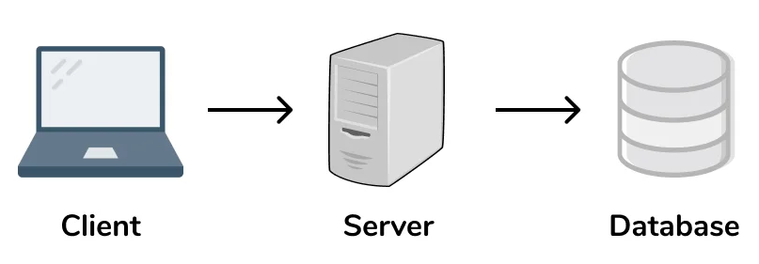

Q1. What is Angular?
Q1
What is Angular?
Angular is a component-based framework for building structured, scalable and single page web applications for client side.
Like we have .NET, Spring, Laravel framework for Server side programming. Similarly we have Angular framework for Client side programming.
CSS
HTML
Javascript
(languages)
C#
Java
PHP…
(languages)
Angular
(framework)
.NET(C#)
Spring(Java)
Laravel(PHP)
(framework)
Back to chapter index

Slide 14
Q1
What is Angular?
What is single page application?
In Single Page Application, we only have one page and the body content of that page will be updated as per the request.
For example, in the image we have single page with multiple components. These components will be replaced by the new components to display the data but the page will remain same.
Single Page Application
Header Component
Signup Component
Login Component
Footer Component
Back to chapter index

Slide 15





Q2. What are Angular advantages?
Q2
What are Angular advantages?
1. It is Relatively simple to build Single Page Applications (by using Components)
2. Flexible and structured client applications (by using OOPS concepts)
3. Angular is cross platform and open source(Free to use)
4. Writing Reusable Code is easy (by using Services)
5. Testing is easy (by using spec.ts)
Back to chapter index

Slide 16
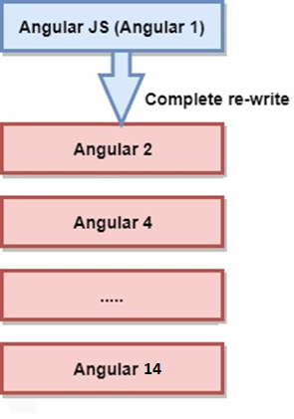
Q3. What is the difference between AngularJS and Angular?
Q3
What is the difference between Angular and Angular JS? OR What are the advantages of Angular over AngularJS?
In the image, you can see Angular History from Angular JS to Angular 14 and more….
Back to chapter index

Slide 17
Q3
What is the difference between Angular and Angular JS? OR What are the advantages of Angular over AngularJS?
Angular JS
Angular
1. It only supports JavaScript.
It
support both JavaScript
and
TypeScript.
2. This framework has a model
-
view
-
This framework has a component
controller (MVC) architecture.
based architecture.
3. It does not have CLI tool.
It has CLI tool.
4
.
It does not use Dependency Injection.
It uses Dependency Injection.
5
.
It does not support mobile browsers.
It also support mobile browsers.
6. It is not so fast
It is very fast
Back to chapter index

Slide 18



Q4. What is NPM?
Q4
What is NPM?
NPM(Node package manager) is an online repository, from where you can get thousands of free libraries which can be used in your angular or node js projects.
Back to chapter index

Slide 19
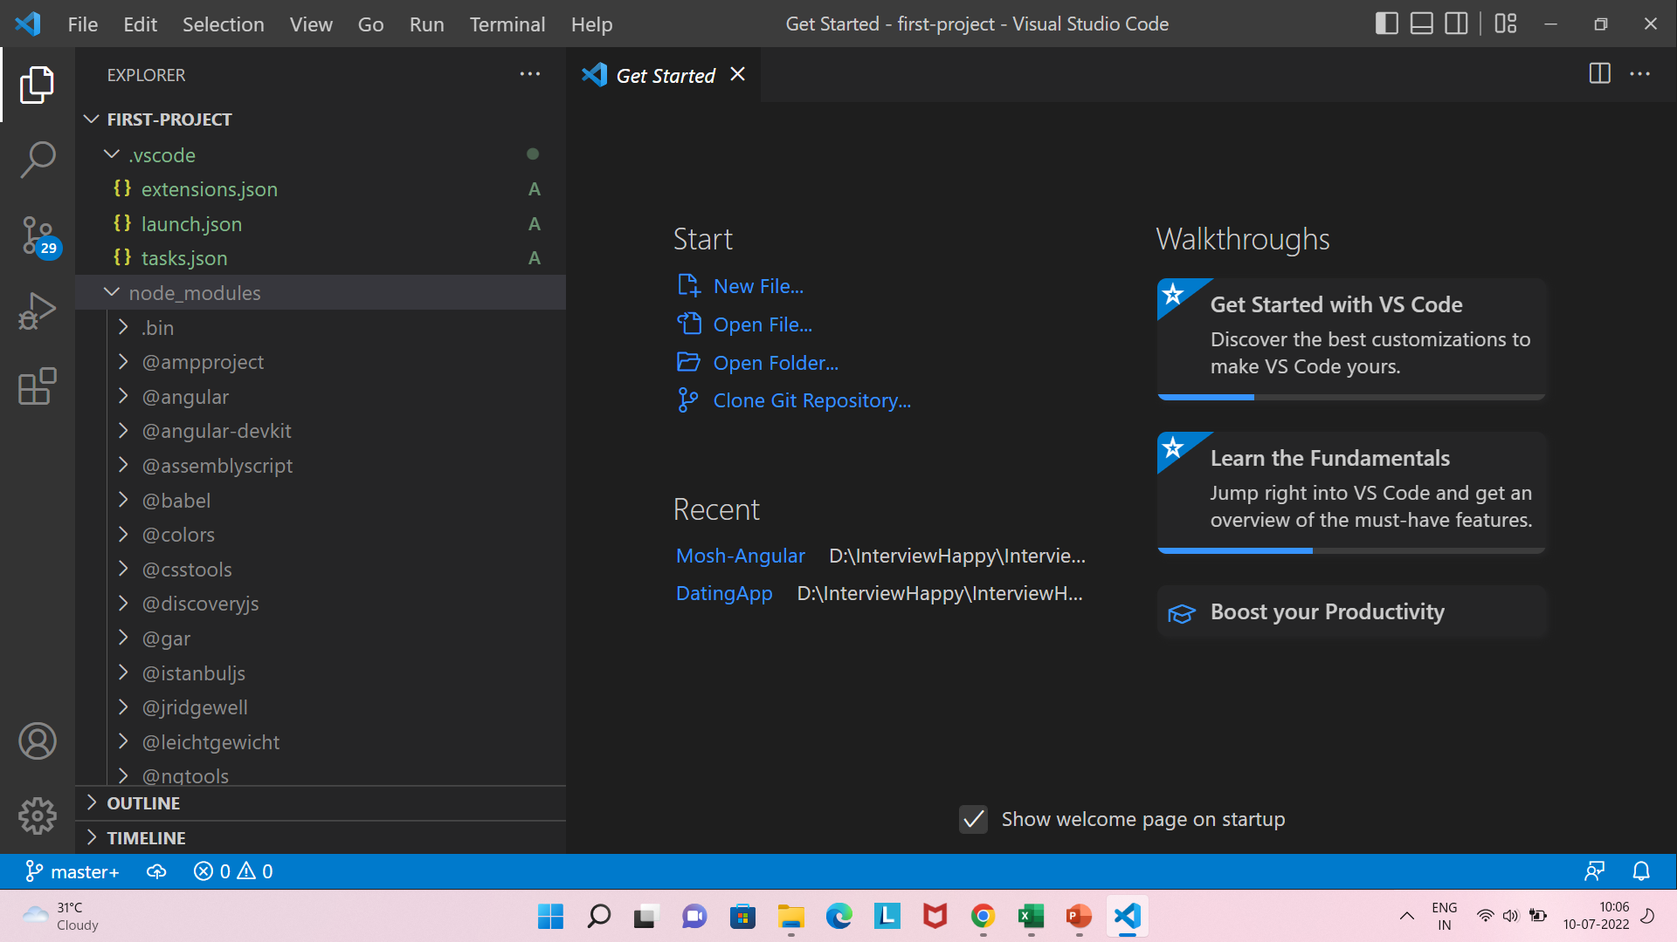
Q4
What is NPM?
The node_modules folder is used to save all downloaded packages from npm in your Angular project.
Back to chapter index

Slide 20
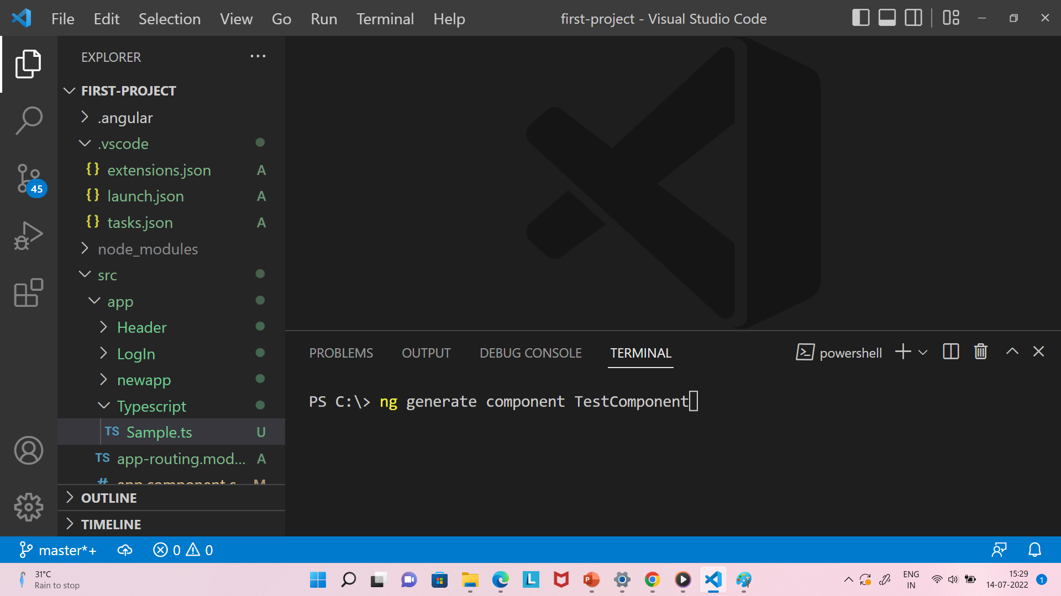
Q5. What is CLI tool?
Q5
What is CLI tool?
The Angular CLI(command-line interface) is a tool that you use to initialize and develop Angular applications directly from Terminal.
For example, you can create a component in your Angular project via CLI terminal (shown below)
Back to chapter index

Slide 21
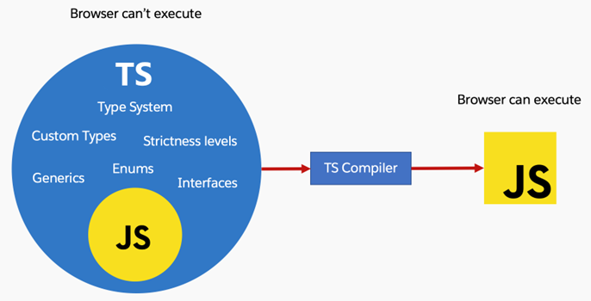
Q6. What is Typescript? What are the advantages of Typescript over Javascript?
Q6
What is Typescript? What are the advantages of Typescript over Javascript?
Typescript is an open-source programming language. It’s advantage are:
Typescript is a strongly typed language.
Typescript is a superset of JavaScript.
It has Object oriented features.
Detect error at compile time.
In image, you can see TS(Typescript) contains JS(Javascript) and other additional features(type system, custom types, generics, enums, interfaces).
Browser can’t execute typescript, so finally TS Compiler will convert the TS to JS only, which browser can understand.
Back to chapter index

Slide 22
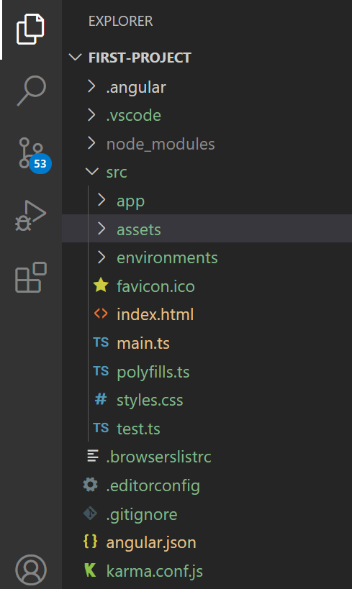
Q7. Where to store static files in Angular project?
Q7
Where to store static files in Angular project?
Store static files in assets folder of the Angular project.
Back to chapter index

Slide 23
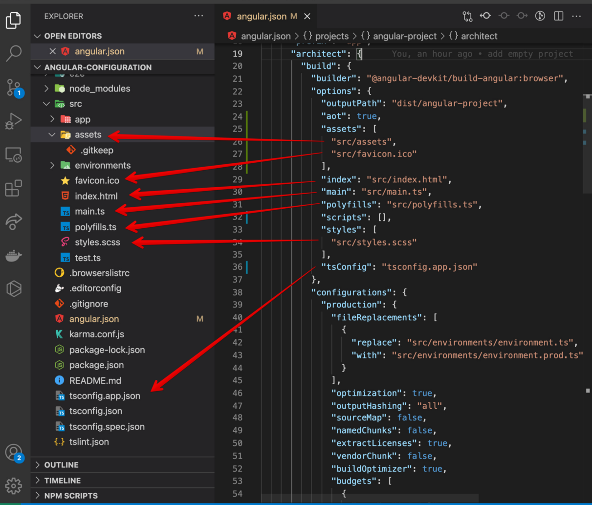
Q8. What is the role of Angular.json file in Angular?
Q8
What is the role of Angular.json file in Angular?
The angular.json file is the primary configuration file for an Angular project.
Configuration file means, in image you see the angular.json file contains all the links of all the files in Angular project.
Back to chapter index

Slide 24

Q9. What is the difference between JIT and AOT in Angular?
Q9
What is the difference between JIT and AOT in Angular?
Both JIT and AOT are used to compile Angular Typescript components to Javascript, because browser understands Javascript not Typescript.
ANGULAR COMPILE | DETAILS
Just-in-Time (JIT) | Compiles your application in the browser at runtime. This was the default until Angular 8.
Ahead-of-Time (AOT) | Compiles your application and libraries at build time. This is the default starting in Angular 9.
All the latest Angular versions use AOT to compile Typescript to Javascript.
Advantage of AOT - Loading in AOT is much quicker than the JIT, because it already has compiled your code at build time.
Back to chapter index

Slide 25
Chapter 2:
Components & Modules
Q10. What are Components in Angular?
Q11. What is a Selector and Template?
Q12. What is Module in Angular? What is app.module.ts file?
Q13. How an Angular App gets Loaded and Started? What are index.html, app-root, selector and main.ts?
Q14. What is a Bootstrapped Module & Bootstrapped Component?
TOP 100
ANGULAR INTERVIEW QUESTIONS
Back to main index

Slide 26
Q10. What are Components in Angular?
Q10
What are Components in Angular?
Components are the most basic UI building block of an Angular app.
Single Page – InterviewHappy.com
Menu Component
Remember Angular is a Single Page Application.
For example, in the image we have single page with multiple components. These components will be replaced by the new components to display the data but the page will remain same.
So, all these small-small components are like the building block only.
Product List Component
Log In Component
Back to chapter index

Slide 27
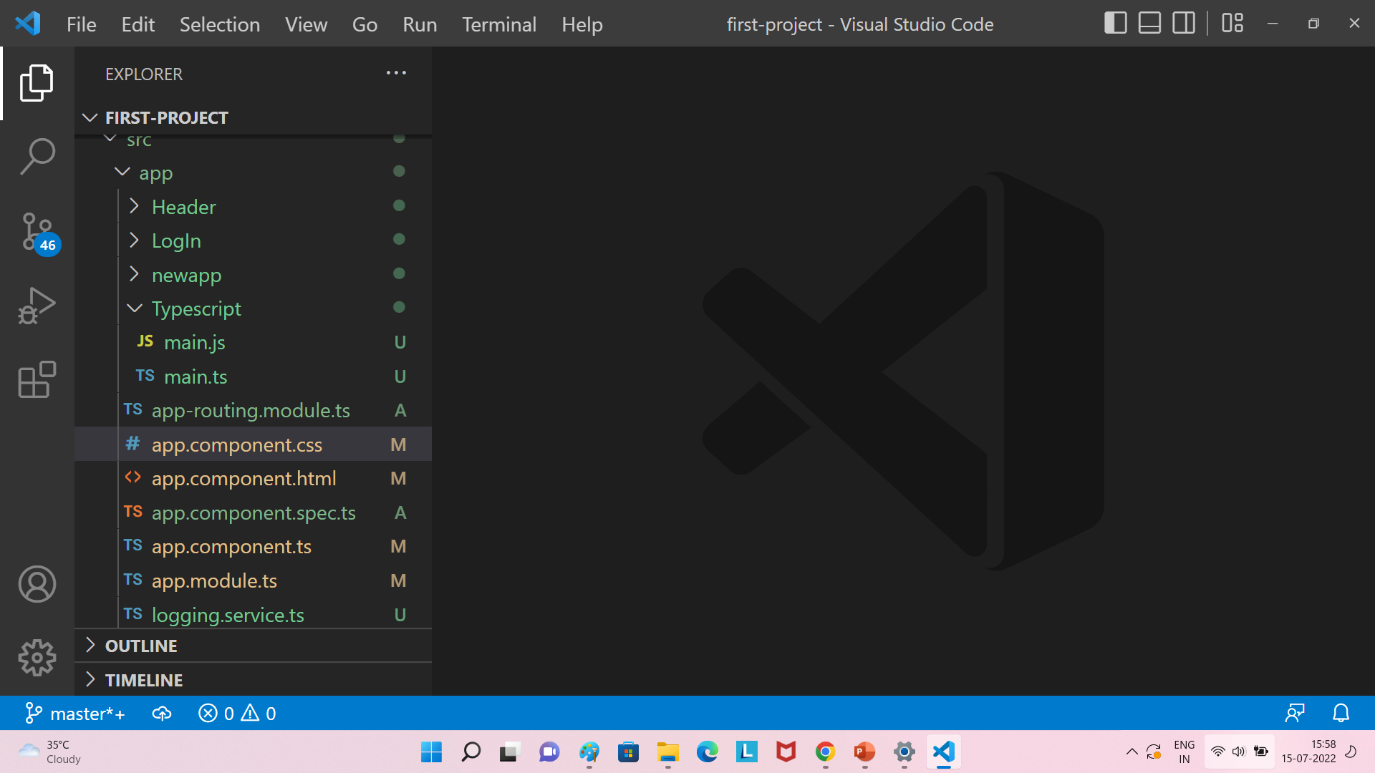
Q10
What are Components in Angular?
Combination of all these 4 files(css, html, spec.ts and ts) is one app-component
Back to chapter index

Slide 28
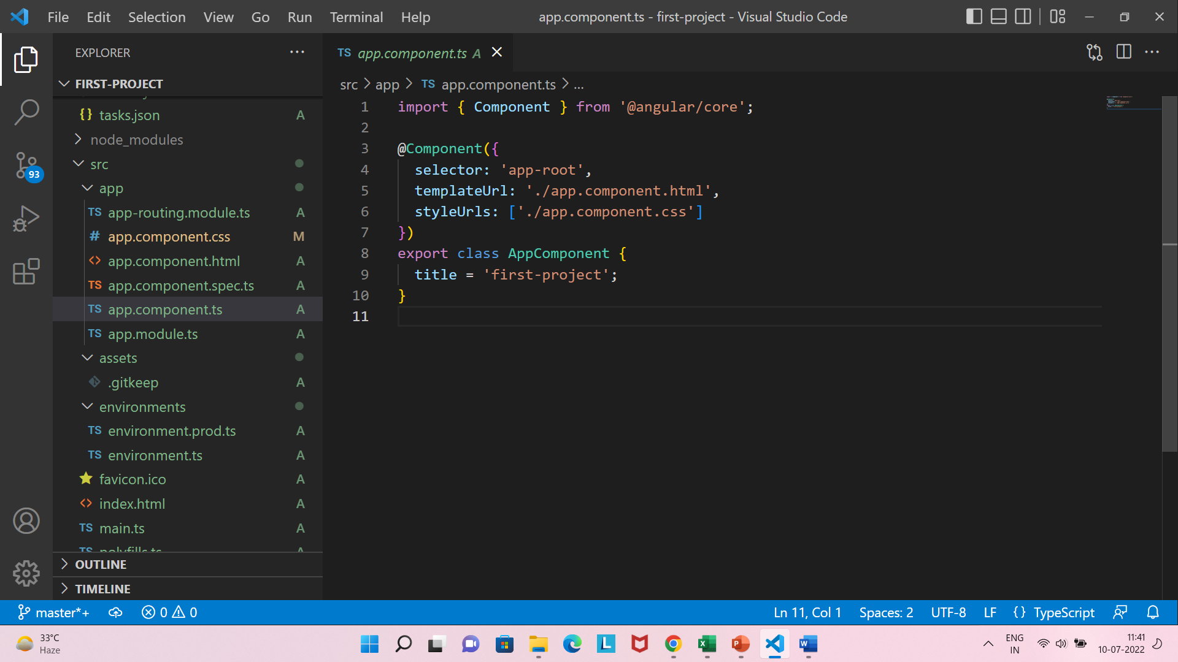
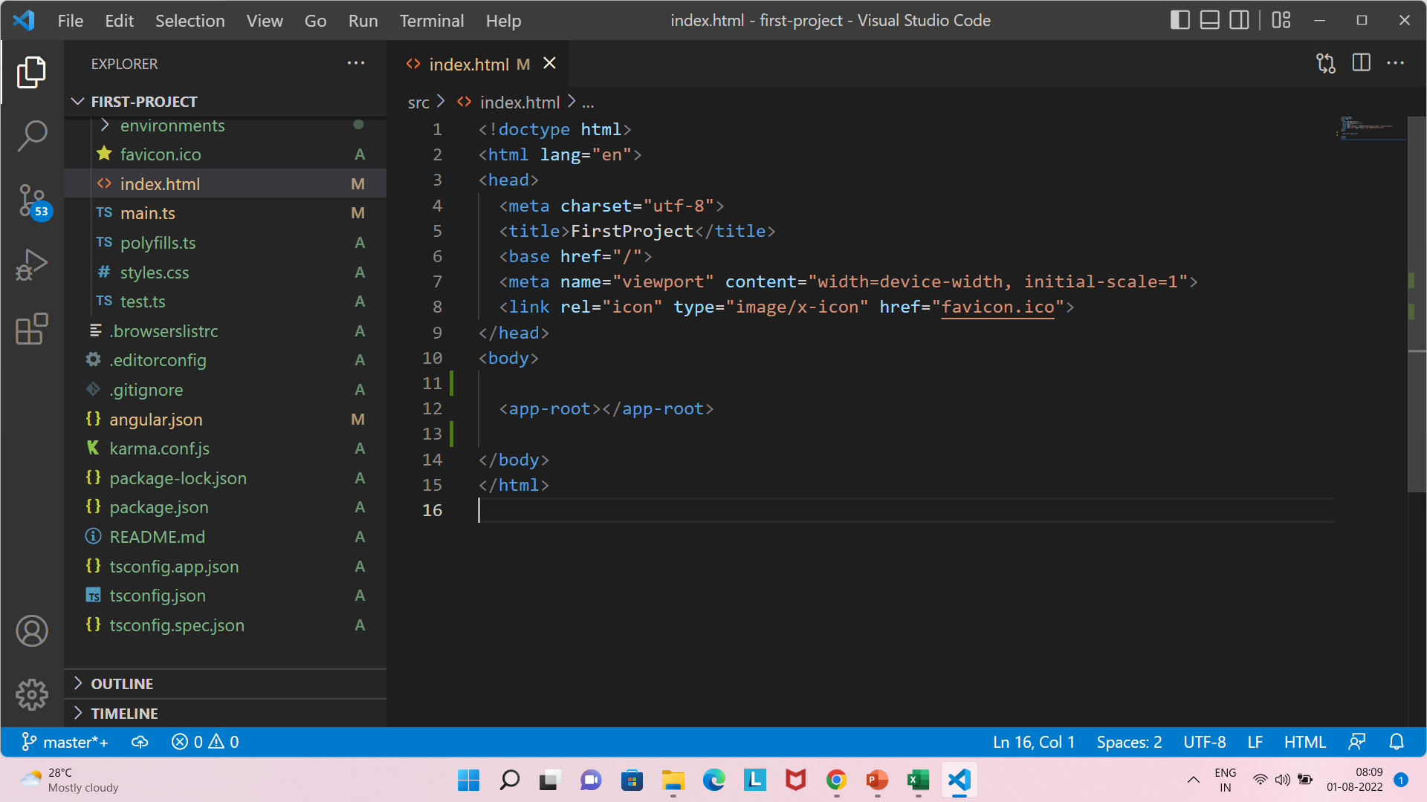
Q11. What is a Selector and Template?
Q11
What is a Selector and Template?
A selector is used to identify each component uniquely into the component tree.
In first image, the app-component selector name is “app-root”. And in second picture we are using this selector to position the component in index.html.
Back to chapter index

Slide 29
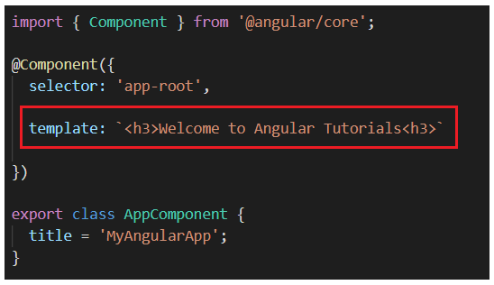
Q11
What is a Selector and Template ?
A Template is a HTML view of an Angular component.
And templateUrl is the link of the HTML template file.
Back to chapter index

Slide 30
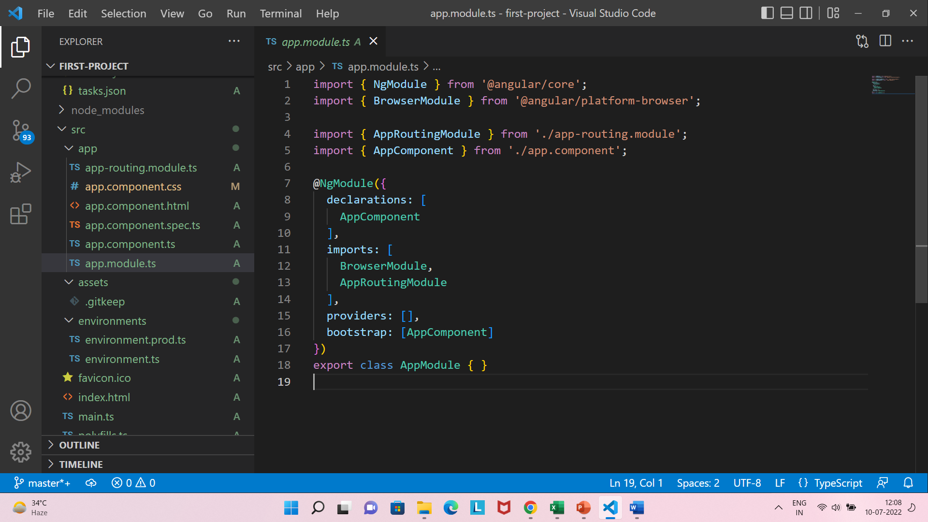
Q12. What is Module in Angular? What is app.module.ts file?
Q12
What is Module in Angular? What is app.module.ts file?
Module is a place where you can group the components, directives, pipes, and services, which are related to the application.
For example, here in this module, we have one component two imports.
Back to chapter index

Slide 31
Q13. How an Angular App gets Loaded and Started? What are index.html, app-root, selector and main.ts?
Q13
How an Angular App gets Loaded and Started? What are index.html, app-root, selector and main.ts?
5 Steps executed when client send request from browser:
First, request hit index.html page.
Second, Index.html will invoke main.js file(which is the javascript version of main.ts file.)
Third, main.ts compiles the web-app and bootstraps the app.module.ts file.
Fourth, App-Module file will then bootstrap the app-component.
Finally, the App-component html will be displayed.
Request
1. Index.html
2. Main.ts
3. app.module.ts
4. App-component
5. Display App-Component HTML
Back to chapter index

Slide 32
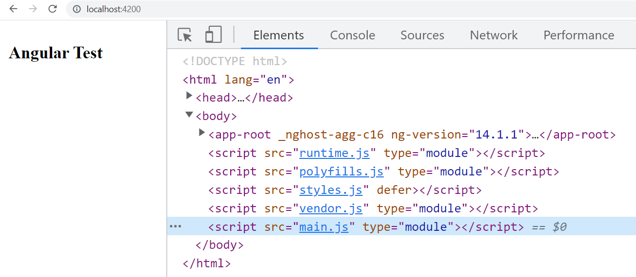
Q13
How an Angular App gets Loaded and Started? What are index.html, app-root, selector and main.ts?
Now let's explore each step-in detail:
First step is request will hit index.html.
Then second step is, Index.html will invoke main.js file which is the javascript version of main.ts file.
Angular is used to create Single Page Applications. Index.html file is that single page.
See in image, when client hit index.html, then angular cli load these js files, with the html file. One js file among them is main.js, which will be executed then.
Back to chapter index

Slide 33
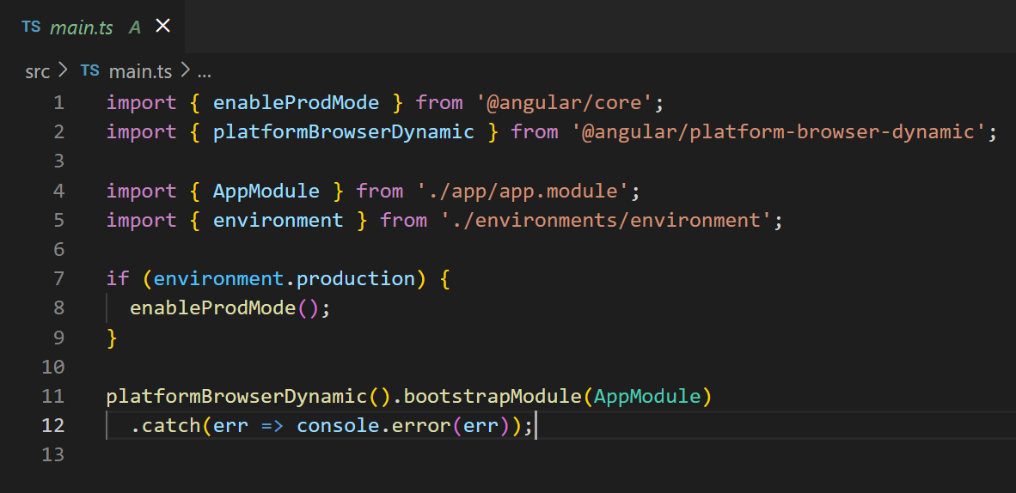
Q13
How an Angular App gets Loaded and Started? What are index.html, app-root, selector and main.ts?
3. Third step is, main.ts compiles the web-app and bootstraps the app.module.ts file.
In the image, you can see how main.ts has bootstrapped the AppModule file.
Back to chapter index

Slide 34
Q13
How an Angular App gets Loaded and Started? What are index.html, app-root, selector and main.ts?
4. Fourth step is, App-Module file will then bootstrap the app-component.
In the image, you can see how app.module.ts has bootstrapped the AppComponent file.
5. Fifth step is, App-component html will be sent to client and displayed in the browser.
Back to chapter index

Slide 35
Q14. What is a Bootstrapped Module & Bootstrapped Component?
Q14
What is a Bootstrapped Module & Bootstrapped Component?
The module which loaded first, when the Angular application start is called Bootstrapped module.
By default, AppModule is the Bootstrapped module in Agular project.
Back to chapter index

Slide 36
Q14
What is a Bootstrapped Module & Bootstrapped Component?
The component which loaded first, after the module is called Bootstrapped component.
By default, AppComponent is the Bootstrapped component in Agular project.
Back to chapter index

Slide 37
Chapter 3:
Data Binding
Q15. What is Data Binding in Angular?
Q16. What is String Interpolation in Angular?
Q17. What is Property Binding in Angular?
Q18. What is Event Binding in Angular?
Q19. What is Two way Binding in Angular?
TOP 100
ANGULAR INTERVIEW QUESTIONS
Back to main index

Slide 38
Q15. What is Data Binding in Angular?
Q15
What is Data Binding in Angular?
Data binding is the way to communicate between your typescript code of your component and html view of component.
Request
TypeScript Code
(app.component.ts)
(Component)
Output Data
HTML Template
(app.component.html)
(View)
Response
Input Data
Back to chapter index

Slide 39
Q15
What is Data Binding in Angular?
4 Types of data binding in Angular:
TypeScript Code
(app.component.ts)
(Component)
1. String Interpolation {{ data }}
HTML Template
(app.component.html)
(View)
2. Property Binding [property] = “data”
Output Data
3. Event Binding (event) = “expression”
Input Data
4. Two way data-binding [(“ ngModel ”)] = “data”
Both ways
Back to chapter index

Slide 40
Q16. What is String Interpolation in Angular?
Q16
What is String Interpolation in Angular?
String Interpolation is a one-way data-binding technique that is used to transfer the data from a TypeScript code(component) to an HTML template (view).
TypeScript Code
(app.component.ts)
(Component)
HTML Template
(app.component.html)
(View)
One Way
String Interpolation {{ data }}
String interpolation can work on string type only not numbers or any other type.
It is represented inside {{data}} double curly braces.
Back to chapter index

Slide 41
Q17. What is Property Binding in Angular?
Q17
What is Property Binding in Angular?
Property binding is a superset of interpolation.
It can do whatever interpolation can do. In addition, it can set an element property to a non-string data value like Boolean.
TypeScript Code
(app.component.ts)
(Component)
HTML Template
(app.component.html)
(View)
One Way
Property Binding [property] = “data”
When to use property binding and when to use interpolation?
When you want to transfer string only, then use interpolation because of its simplicity(just {{data}}) to use.
When you want to transfer any type other than string, then use property binding.
Back to chapter index

Slide 42

Q18. What is Event Binding in Angular?
Q18
What is Event Binding in Angular?
Event binding is used to handle the events raised by the user actions like button click.
Request
TypeScript Code
(app.component.ts)
(Component)
HTML Template
(app.component.html)
(View)
One way
Event Binding (event) = “expression”
Back to chapter index

Slide 43
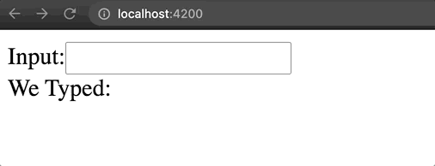
Q19. What is Two way Binding in Angular?
Q19
What is Two way Binding in Angular?
Two-way data binding in Angular will help users to exchange data from the view to component and then from component to the view at the same time.
TypeScript Code
(app.component.ts)
(Component)
HTML Template
(app.component.html)
(View)
Two way data-binding [(“ ngModel ”)] = “data”
Back to chapter index

Slide 44
Chapter 4:
Directives
Q20. What are Directives? What are the type of directives?
Q21. What is *ngIf Structural directive?
Q22. What is *ngFor Structural directive?
Q23. What is *ngSwitch Structural directive?
Q24. What is [ngStyle] Attribute directive?
Q25. What is [ngClass] Attribute directive?
Q26. What is the difference between Component, Attribute and Structural Directives?
TOP 100
ANGULAR INTERVIEW QUESTIONS
Back to main index

Slide 45
Q20. What are Directives? What are the type of directives?
Q20
What are Directives? What are the type of directives?
Directives are classes that add additional behavior to elements in your Angular applications.
For example, in below image, we can change the color of button element by using directives.
Submit
Color change by using Directives
Submit
Back to chapter index

Slide 46
Q20
What are Directives? What are the type of directives?
Types of Directives
Structural
Attribute
Component
*ngIf
*ngFor
*ngSwitch
[ngClass]
[ngStyle]
Types of Directives:
Structural Directives are classes that change appearance of DOM by adding or removing elements.
Attribute directives change the appearance or behavior of an element.
Component directive are directives with its own template.
Back to chapter index

Slide 47
Q21. What is *ngIf Structural directive?
Q21
What is *ngIf Structural directive?
Types of Directives
Structural
Attribute
Component
*ngIf
*ngFor
*ngSwitch
[ngClass]
[ngStyle]
*ngIf is a structural directive, which is used to add or remove items based on the if condition.
Back to chapter index

Slide 48
Q22. What is *ngFor Structural directive?
Q22
What is *ngFor Structural directive?
Types of Directives
Structural
Attribute
Component
*ngIf
*ngFor
*ngSwitch
[ngClass]
[ngStyle]
*ngFor is a structural directive, which is used to iterate a list of items and then display them.
Back to chapter index

Slide 49
Q23. What is *ngSwitch Structural directive?
Q23
What is *ngSwitch Structural directive?
Types of Directives
Structural
Attribute
Component
*ngIf
*ngFor
*ngSwitch
[ngClass]
[ngStyle]
ngSwitch is a structural directive, which is used in combination with *ngSwitchCase and *ngSwitchDefault that are both structural directives.
Back to chapter index

Slide 50
Q24. What is [ngStyle] Attribute directive?
Q24
What is [ngStyle] Attribute directive?
Types of Directives
Structural
Attribute
Component
*ngIf
*ngFor
*ngSwitch
[ngClass]
[ngStyle]
[ngStyle] is an attribute directive, which is used to updates styles of the HTML element.
Back to chapter index

Slide 51
Q25. What is [ngClass] Attribute directive?
Q25
What is [ngClass] Attribute directive?
Types of Directives
Structural
Attribute
Component
*ngIf
*ngFor
*ngSwitch
[ngClass]
[ngStyle]
[ngClass] is an attribute directive, which is used to add and remove CSS classes on an HTML element.
Back to chapter index

Slide 52
Q26. What is the difference between Component, Attribute and Structural Directives?
Q26
What is the difference between Component, Attribute and Structural Directives?
Component Directive
Structural Directive
Attribute Directive
1.
Component directive is
Structural directive is
Attribute directive is
responsible for showing
responsible for adding
responsible for changing the
the first whole view.
and deleting html
appearance of view by
It is the most used one.
elements in the view.
adding or removing
styles/
cssclasses
of the html
elements.
2.
Starts with @ sign.
Starts with * sign.
Set inside square brackets.
Like: @Component
Like: *
ngIf
, *
ngFor
,
Like
: [
ngClass
], [
ngStyle
]
*
ngSwitch
Back to chapter index

Slide 53
Chapter 5:
Decorator & Pipes
Q27. What is Decorator?
Q28. What are the types of Decorator?
Q29. What are Pipes? What are the types of Pipes & Parameterized Pipes?
Q30. What is Chaining Pipes?
TOP 100
ANGULAR INTERVIEW QUESTIONS
Back to main index

Slide 54
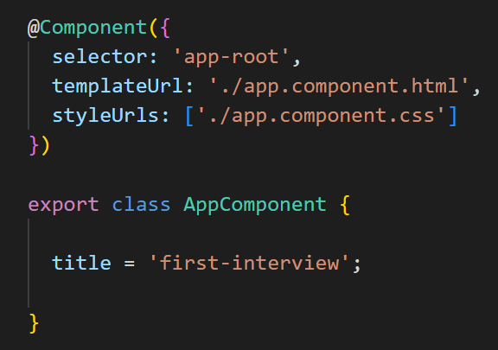

Q27. What is Decorator?
Q27
What is Decorator?
Angular decorators store metadata about a class, method, or property.
For example, in image @Component decorator store metadata information about the app-component.
All decorators are represented with @ symbol.
Metadata
What is Metadata?
Metadata is "data that provides information about other data“.
For example, in image we have a book. Now things like author name, title, price, publisher etc etc, all this information about the book is metadata only.
Meaning metadata gives you some information about the book, but it is not the main content or data of the book. This is metadata.
Back to chapter index

Slide 55
Q28. What are the types of Decorator?
Q28
What are the types of Decorator?
Here are the Types of decorators – Class, Property, Method and Parameter are the categories of decorators. We will use these decorators later in different parts of the Angular applications.
Types of Decorators
Class Decorators
@NgModule
@Component
@Injectable
@Directive
@Pipe
Property Decorators
@Input
@Output
@ContentChild
@ContentChildren
@ViewChild
@ViewChildren
@HostBinding
Method Decorators
@HostListner
Parameter Decorators
@Inject
@Self
@Host
@SkipSelf
@Optional
Back to chapter index

Slide 56
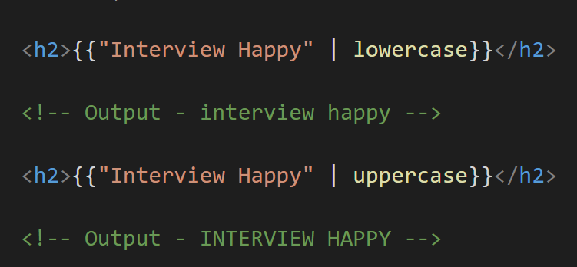
Q29. What are Pipes? What are the types of Pipes & Parameterized Pipes?
Q29
What are Pipes? What are the types of Pipes & Parameterized Pipes?
Pipes are simple functions which accept an input value and return a transformed value.
For example, in image the input is “Interview Happy” and the transformed value is “interview happy”.
Back to chapter index

Slide 57
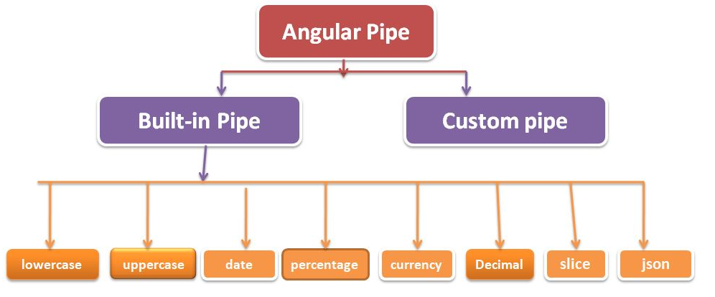
Q29
What are Pipes? What are the types of Pipes & Parameterized Pipes?
Types of Pipes:
Built-in Pipes are provided by Angular framework. Like lowercase, uppercase, date etc.
Custom pipe, we can create and develop ourselves.
Back to chapter index

Slide 58
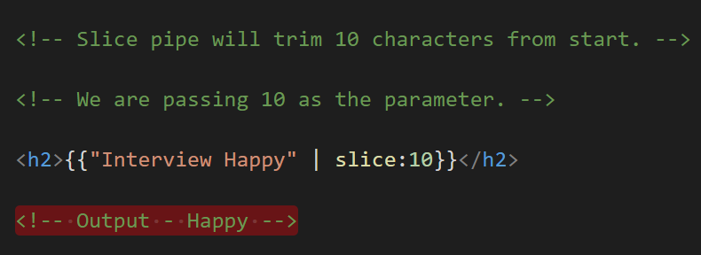
Q29
What are Pipes? What are the types of Pipes & Parameterized Pipes?
When we pass any parameters to the pipes, it is called parameterized pipes.
Back to chapter index

Slide 59
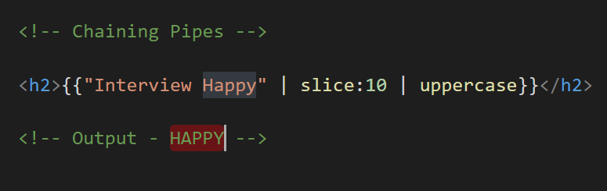
Q30. What is Chaining Pipes?
Q30
What is Chaining Pipes?
The chaining pipes use multiple pipes on a data input.
For example, in below image one pipe is for slice and then other pipe will further transform the result to uppercase
Back to chapter index

Slide 60
Chapter 6:
Services & Dependency Injection
TOP 100
ANGULAR INTERVIEW QUESTIONS
Q31. Explain Services with Example?
Q32. How to create Servicein Angular?
Q33. How to use Dependency Injector with Services in Angular?
Q34. What is Hierarchical Dependency Injection?
Q35. What is Provider in Angular?
Q36. What is the role of @Injectable Decorator in a Service?
Back to main index

Slide 61
Q31. Explain Services with Example?
Q31
Explain Services with Example?
A service is a typescript class and reusable code which can be used in multiple components.
Component A
How to use services in components?
Service can be implemented in components with the help of dependency injection.
Angular Service
(Typescript class & Reusable code)
Component B
Component C
Back to chapter index

Slide 62
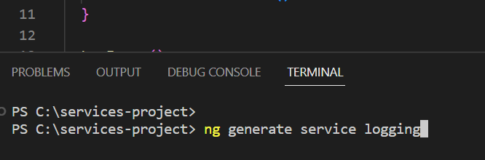
Q32. How to create Service in Angular?
Q32
How to Create Service in Angular?
Below is the command to generate service of name “logging” in Angular
Back to chapter index

Slide 63
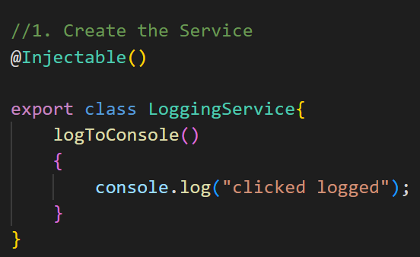
Q33. How to use Dependency Injector with Services in Angular?
Q33
How to use Dependency Injector with Services in Angular?
4 Steps to inject service dependency in the component:
1. First step is, create the service – (LoggingService).
Back to chapter index

Slide 64
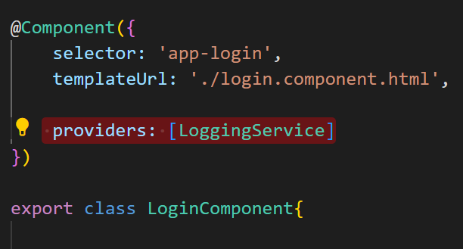
Q33
How to use Dependency Injector with Services in Angular?
2. Second step is, set the providers as the service name(LoggingService), inside the any component decorator as shown below.
Back to chapter index

Slide 65
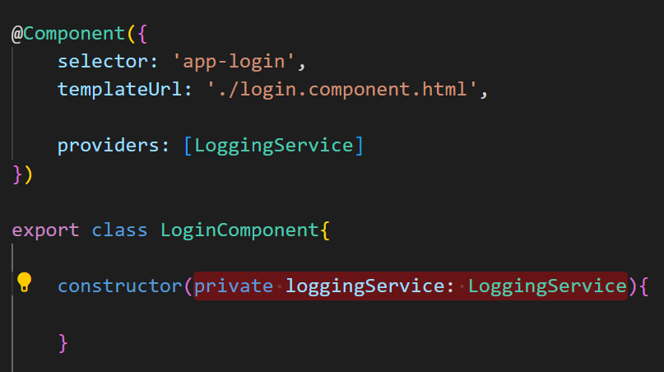
Q33
How to use Dependency Injector with Services in Angular?
3. Third step is, inside the constructor parameter create a new property(loggingService) and then assign the Service type(LoggingService) here.
Back to chapter index

Slide 66
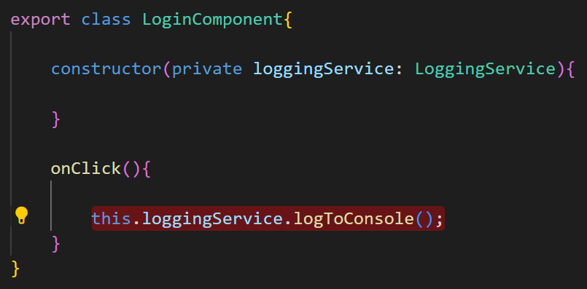
Q33
How to use Dependency Injector with Services in Angular?
4. Finally use the property(loogingService), to call the method(logToConsole) of the LoggingService.
Back to chapter index

Slide 67
Q34. What is Hierarchical Dependency Injection?
Q34
What is Hierarchical Dependency Injection?
As per Angular, if we will inject the service in parent component, then service will be available to all it’s child components, but if we will inject the service directly in child component then it will not be available for Parent and siblings components.
Child Component A1
Angular Service
(Typescript class & Reusable code)
Parent Component A
Child Component A2
Child Component A3
Back to chapter index

Slide 68
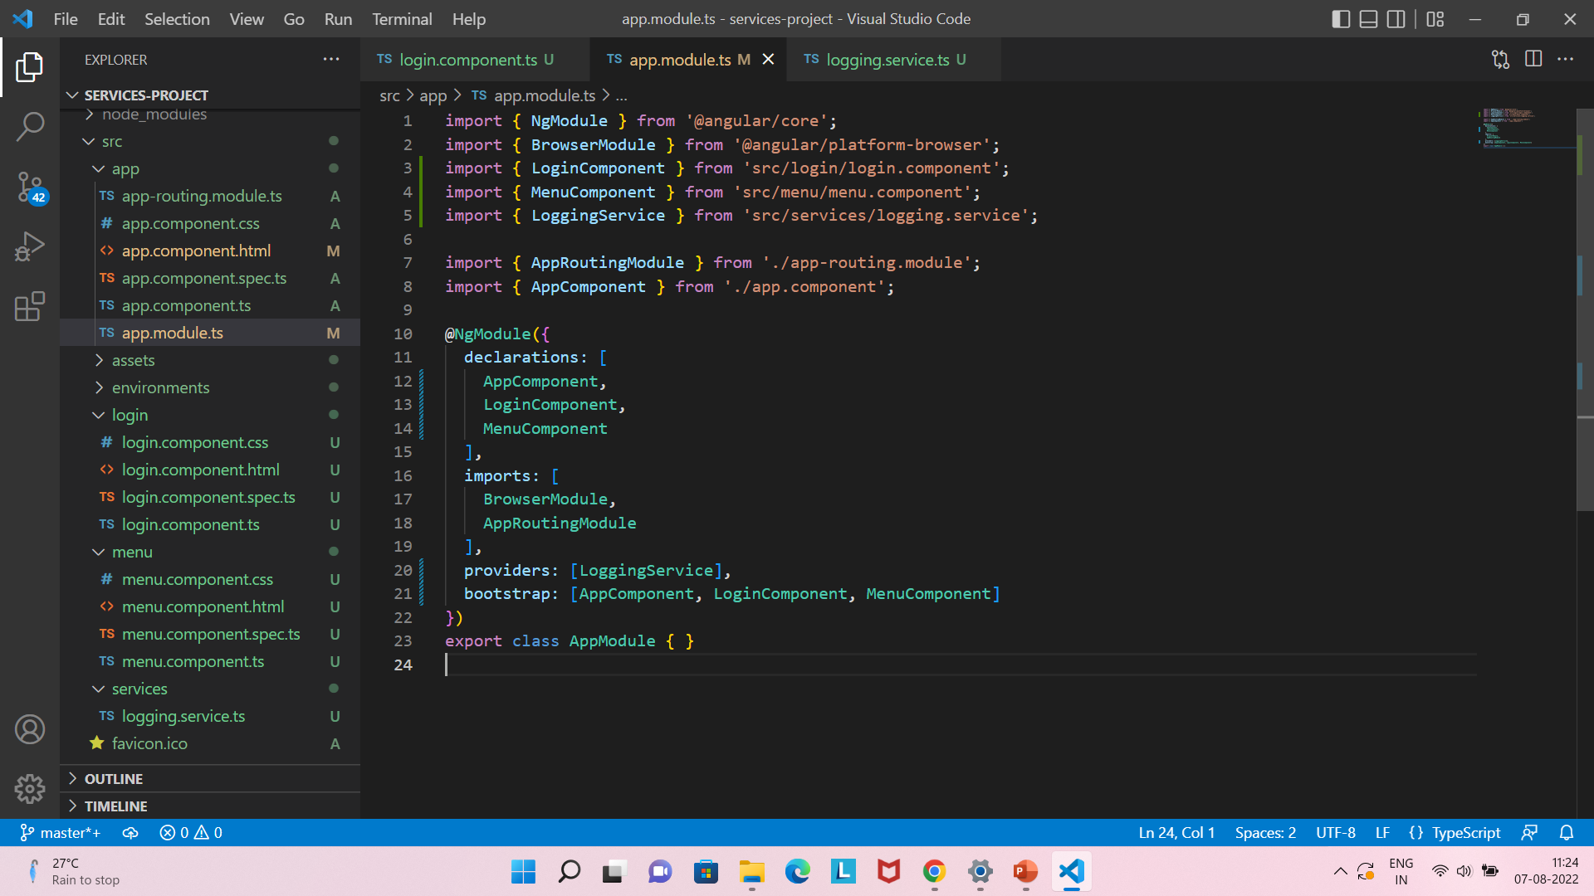
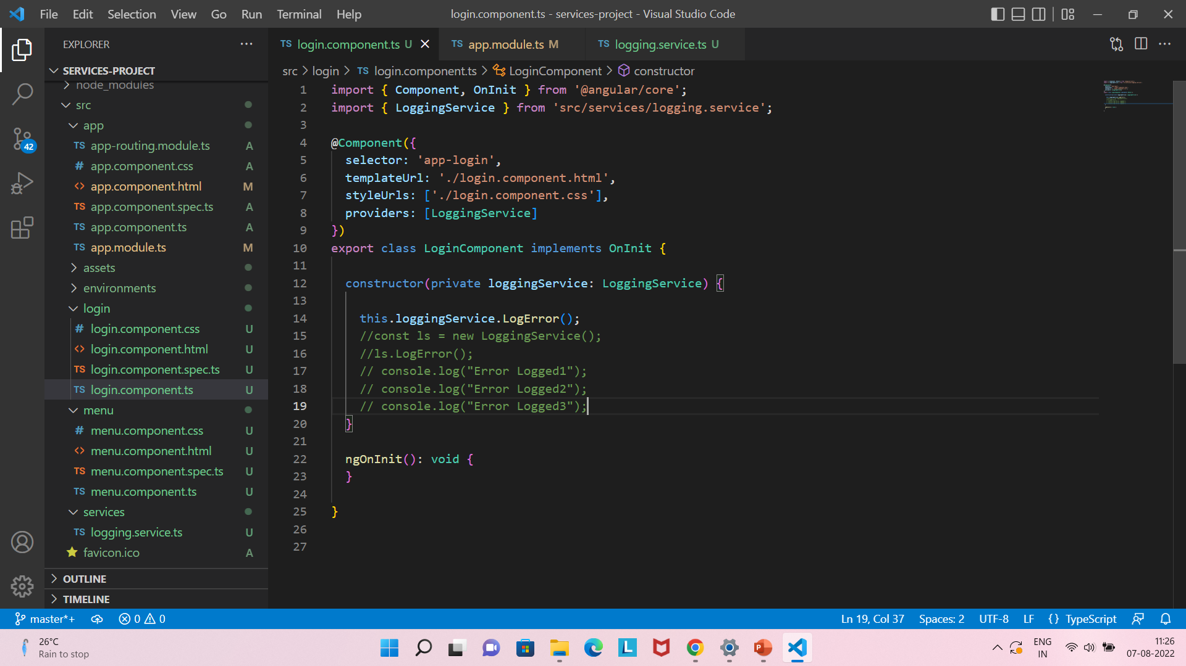
Q35. What is Provider in Angular?
Q35
What is Provider in Angular?
A provider is an object declared inside decorators which inform Angular that a particular service is available for injecting inside the components.
Provider can be set in module or in the component as shown below.
Back to chapter index

Slide 69
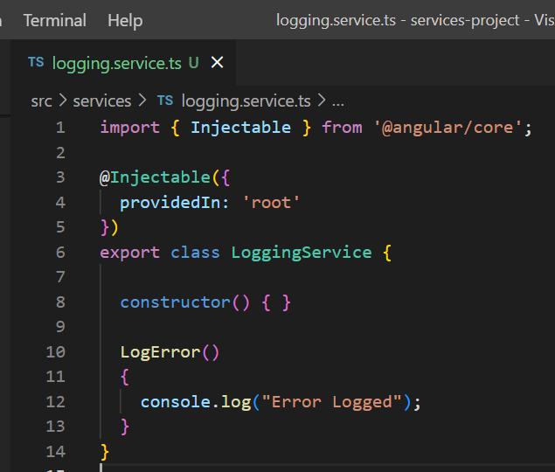
Q36. What is the role of @Injectable Decorator in a Service?
Q36
What is the role of @Injectable Decorator? How to use one service inside another service?
With @Injectable decorator one service can be used by another service.
For example, in image we set the LoggingService as Injectable. That means, now any other service also can use LoggingService methods.
Back to chapter index

Slide 70
Chapter 7:
Decorators & Lifecycle-Hooks
TOP 100
ANGULAR INTERVIEW QUESTIONS
Q37. What are Parent-Child Components?
Q38. What is @Input Decorator? How to transfer data from Parent component to Child component?
Q39. What is @Output Decorator and Event Emitter?
Q40. What are Lifecycle Hooks in Angular?
Q41. What is a Constructor in Angular?
Q42. What is ngOnChanges life cycle hook in Angular?
Q43. What is ngOnInit life cycle hook in Angular?
Q44. What is the difference between constructor and ngOnInit?
Back to main index

Slide 71
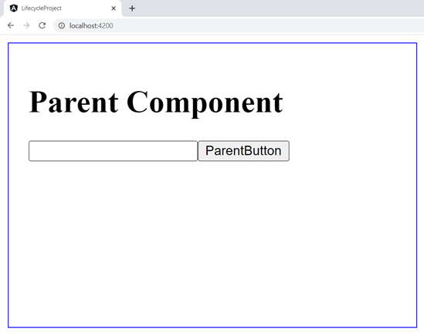
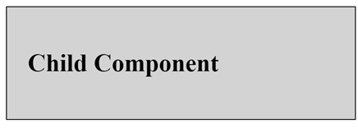
Q37. What are Parent-Child Components?
Q37
What are Parent-Child Components?
Parent component is the outer component.
Child components are the components inside the parent component.
Most of the time app-component is only the parent component and rest of the components are child components
Back to chapter index

Slide 72
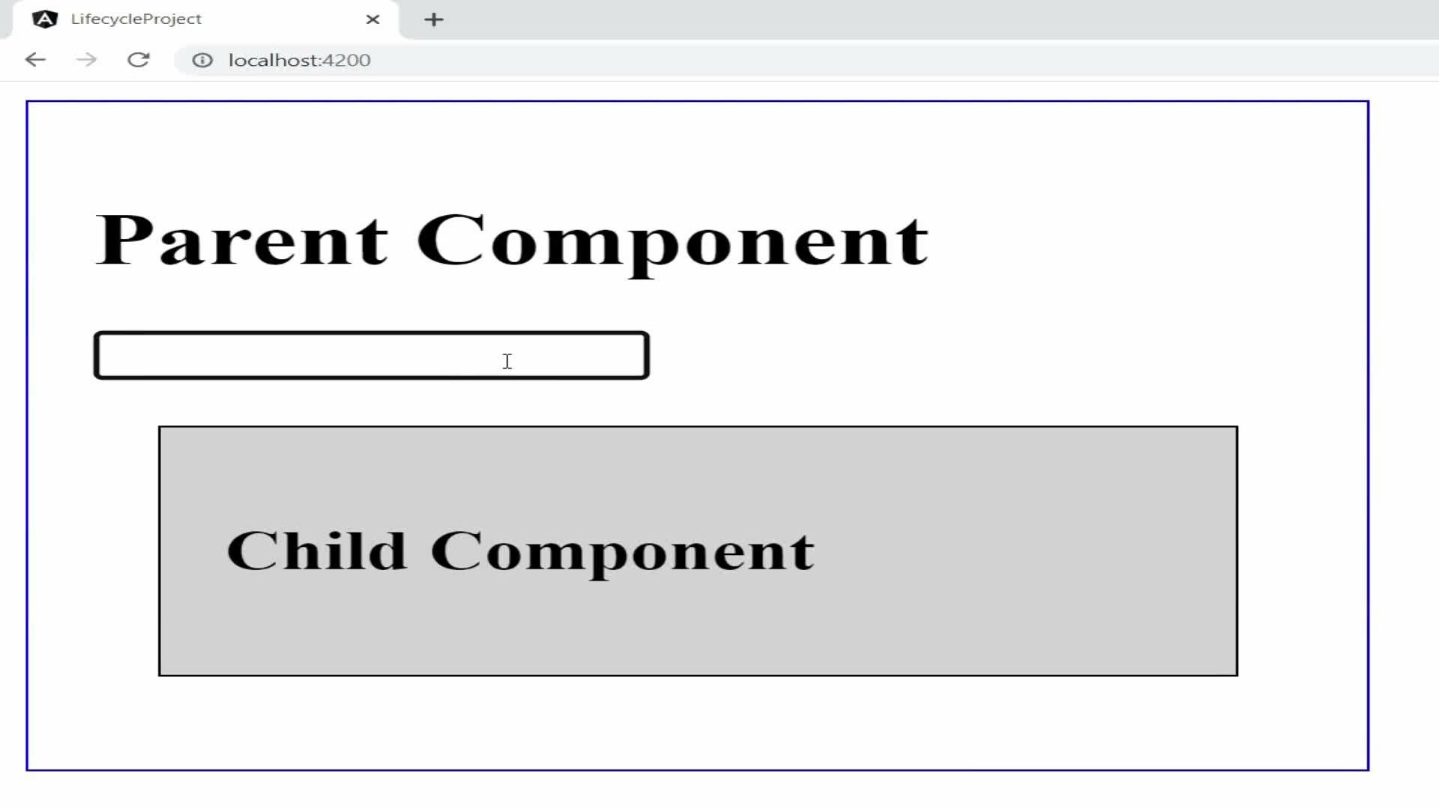
Q38. What is @Input Decorator? How to transfer data from Parent component to Child component?
Q38
What is @Input Decorator? How to transfer data from Parent component to Child component?
@Input decorator is used to pass data from parent component to child component.
app.component.html
(Parent)
@Input
child.component.ts
(Child)
Back to chapter index

Slide 73
Q38
What is @Input Decorator? How to transfer data from Parent component to Child component?
@Input decorator is used to pass data from parent component to child component.
Two way binding
app.component.html
(Parent)
app.component.ts
(Parent)
@Input
child.component.ts
(Child)
child.component.html
(Child)
Interpolation
Back to chapter index

Slide 74
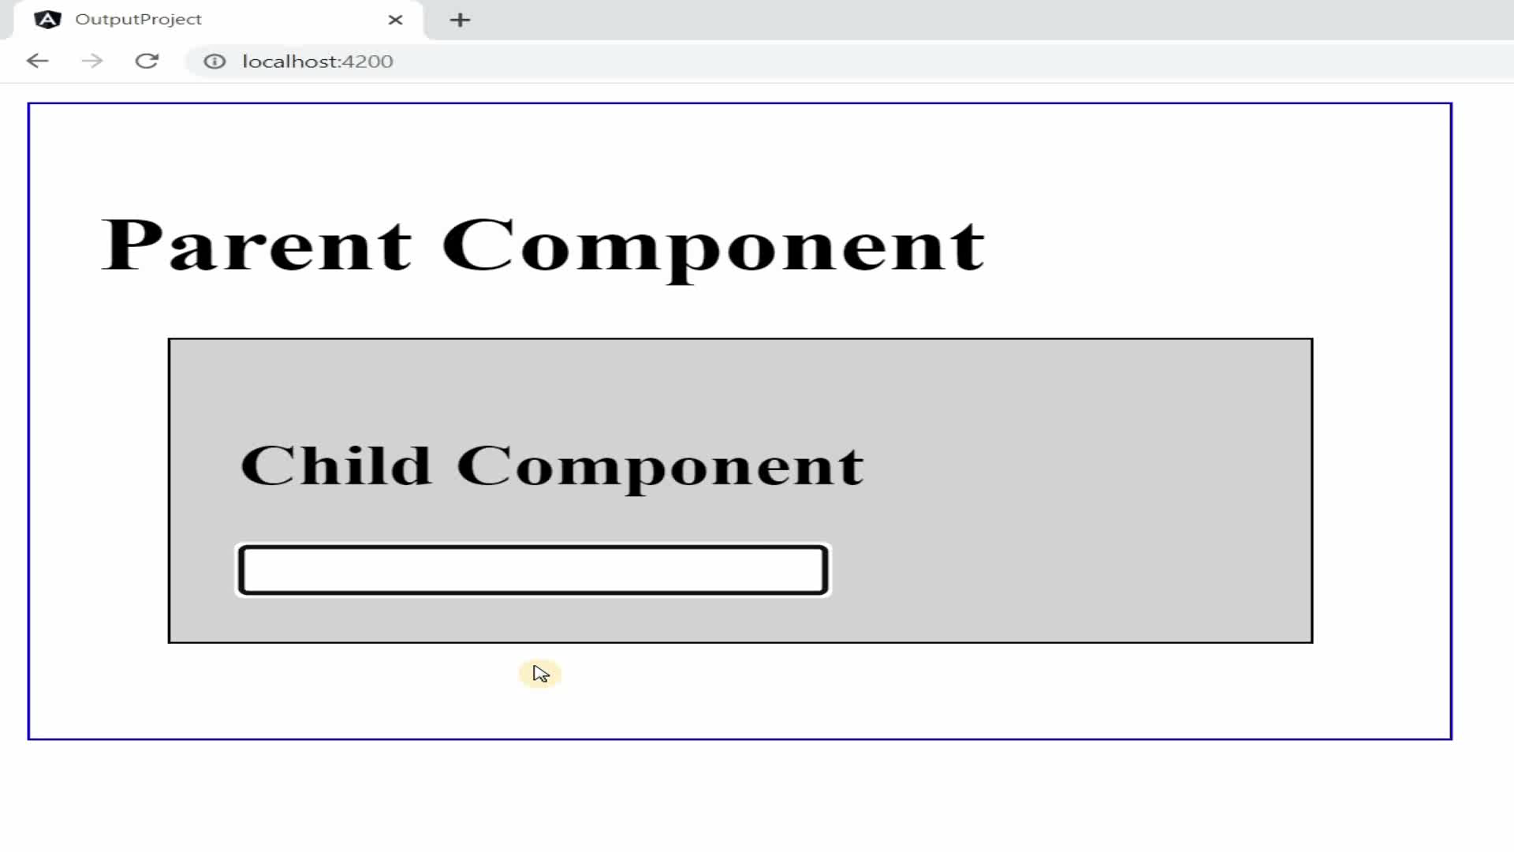
Q39. What is @Output Decorator and Event Emitter?
Q39
What is @Output Decorator and Event Emitter?
@Ouptut decorator and event emitter together are used to pass data from child component to parent component.
app.component.html
(Parent)
@Output/ EventEmitter
child.component.ts
(Child)
Back to chapter index

Slide 75
Q39
What is @Output Decorator and Event Emitter?
@Ouptut decorator and event emitter together are used to pass data from child component to parent component.
Event Binding
app.component.html
(Parent)
app.component.ts
(Parent)
Interpolation
@Output/ EventEmitter
child.component.ts
(Child)
child.component.html
(Child)
Event Binding
Back to chapter index

Slide 76
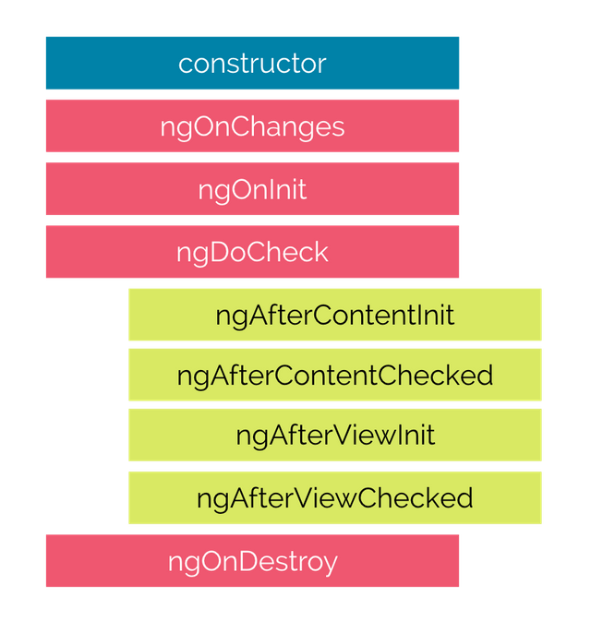
Q40. What are Lifecycle Hooks in Angular?
Q40
What are Lifecycle Hooks in Angular?
A component from creation to destruction goes through several stages and these stages are the life cycle hooks.
The stages will cover activities like:
Component instantiating.
Rendering the component html view.
Creating the child components(optional).
Destroying the component.
Angular provides these hooks, inside them we can code for appropriate functionality.
Back to chapter index

Slide 77
Q40
What are Lifecycle Hooks in Angular?
Here are some details about the hooks:
It is a default method of the typescript class that is executed when the class is instantiated.
It always run before any angular hook and it is not a part of Lifecycle Hooks.
Called when input property changes.
Called when the component is created.
Called for component children.
Called when the component is destroyed.
Back to chapter index

Slide 78
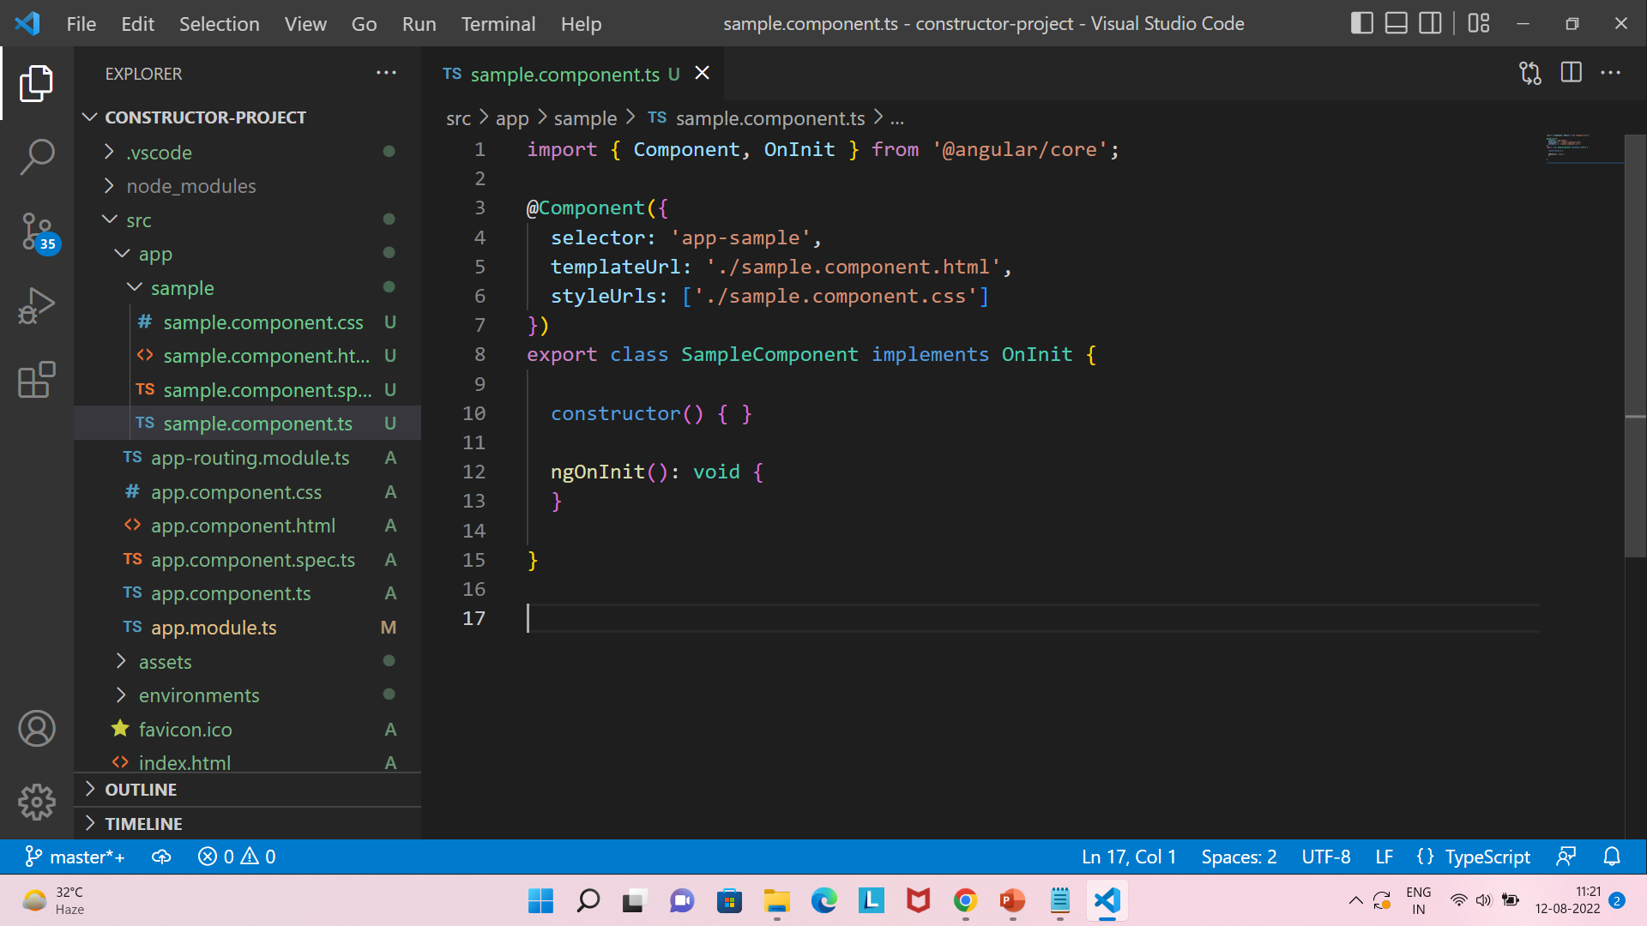
Q41. What is a Constructor in Angular?
Q41
What is a Constructor in Angular?
The constructor is a method in a TypeScript class that automatically gets called when the class is being instantiated.
Whether constructor is a life cycle hook?
Constructor always run before any angular hook and it is not a part of Lifecycle Hooks.
One example, when we have to write code inside constructor?
Constructor is widely used to inject dependencies(services) into the component class.
Back to chapter index

Slide 79
Q42. What is ngOnChanges life cycle hook in Angular?
Q42
What is ngOnChanges life cycle hook in Angular?
The ngOnChnages is the first life cycle hook, which angular fires when it detects any changes to the input property.
Back to chapter index

Slide 80
Q43. What is ngOnInit life cycle hook in Angular?
Q43
What is ngOnInit life cycle hook in Angular?
1. NgOnInit signals the activation of the created component.
2. This is the second hook and called after ngOnChanges.
3. NgOnInit called only once during lifecycle.
4. By default, present in the component.
Back to chapter index

Slide 81
Q44. What is the difference between constructor and ngOnInit?
Q44
What is the difference between Constructor and ngOnInit?
ngOnInit
Constructor
1.
NgOnInit
is an
Angular lifecycle hook
,
The constructor is
a method in a
TypeScript
which signals the activation of the
class,
that automatically gets called when the
created component.
class is being instantiated.
2.
ngOnInit
is called
after
ngOnChanges
Constructor is called
before
any lifecycle
-
lifecycle
-
hook.
hook.
3. When
ngOnInit
called, everything
about component is already ready, so it’s
When constructor called, everything in
use is to perform most of the
business
component is not ready, so it's mostly used for
logic
on component.
injecting dependencies
only
.
Back to chapter index

Slide 82
Chapter 8:
Routing
Q45. What is Routing? How to setup Routing?
Q46. What is router outlet?
Q47. What are router links?
TOP 100
ANGULAR INTERVIEW QUESTIONS
Back to main index

Slide 83
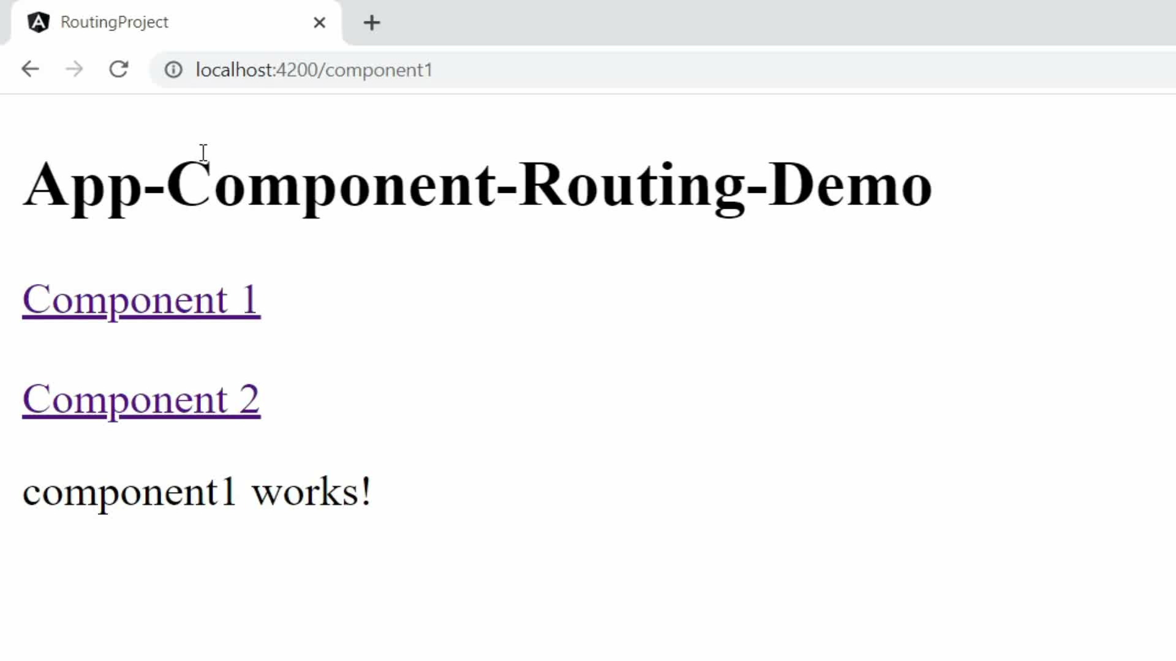
Q45. What is Routing? How to setup Routing?
Q45
What is Routing? How to setup Routing?
Routing helps in navigating from one view to another view with the help of URL.
See here we have two Component links, Component 1 and Component 2 in App-Component.
Now when I click Component 1 link, then the url is updated to component1 and the component displayed is component 1.
Then when I click Component 2 link, then the url is updated to component2 and the component displayed is component 2.
So, in a single page we are navigating from one component to another component, that is routing.
Back to chapter index

Slide 84
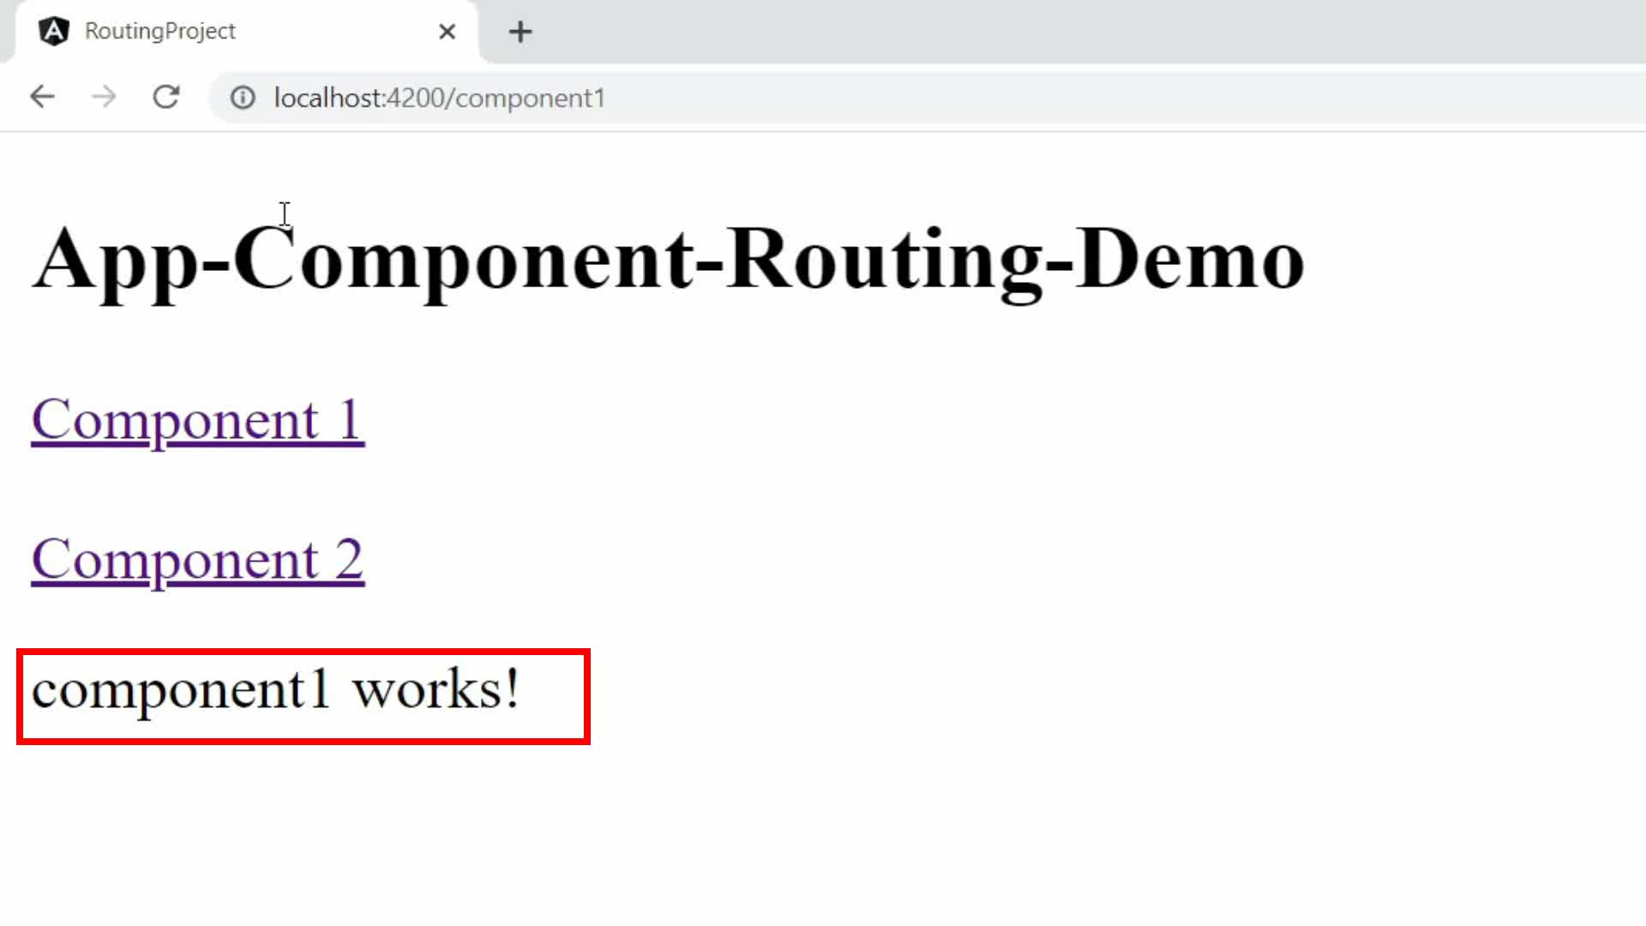
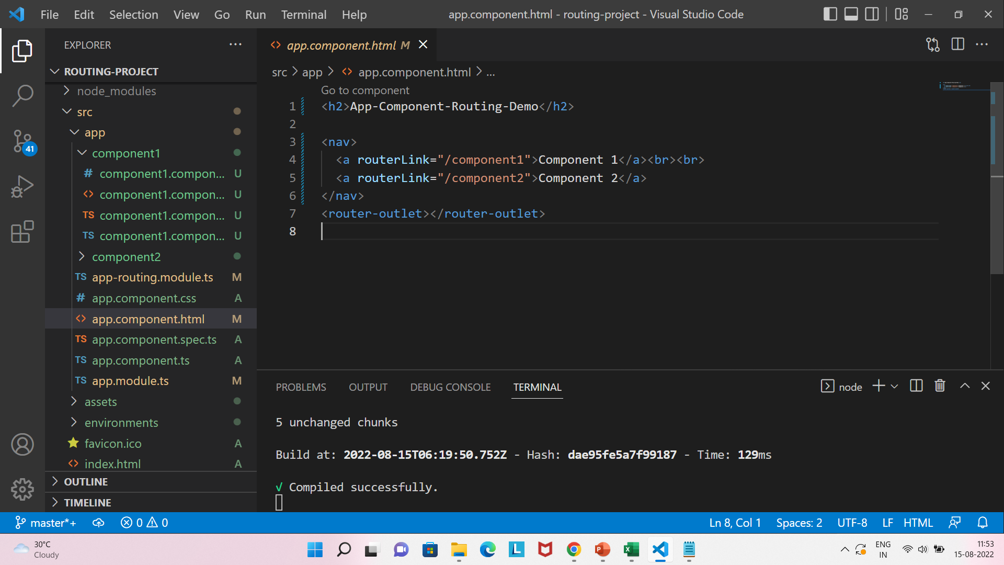
Q46. What is router outlet?
Q46
What is router-outlet in Angular?
Router-outlet in Angular works as a placeholder, which is used to load the different components dynamically based on the activated component via Routing.
Back to chapter index

Slide 85
Q47. What are router links?
Q47
What is router-Link in Angular?
RouterLink is used for navigating to a different route.
Back to chapter index

Slide 86
Chapter 9:
Observable\ HttpClient\ RxJS
TOP 100
ANGULAR INTERVIEW QUESTIONS
Q48. What are Asynchronous operations?
Q49. What is the difference between Promise and Observable?
Q50. What is RxJS?
Q51. What is Observable? How to implement Observable
Q52. What is the role of HttpClient in Angular?
Q53. What are the steps for fetching the data with HttpClient & Observable?
Q54. How to do HTTP Error Handling in Angular?
Back to main index

Slide 87
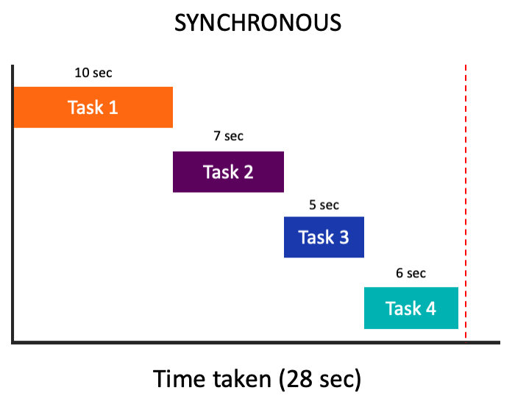
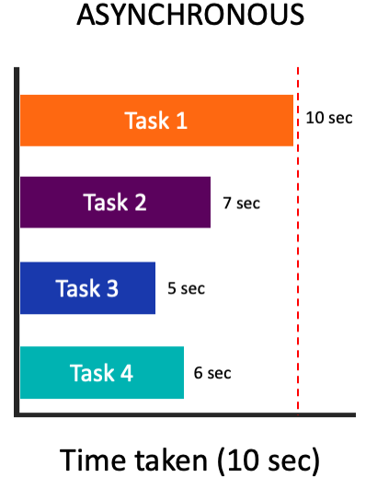
Q48. What are Asynchronous operations?
Q48
What are Asynchronous operations?
In synchronous operations, tasks are executed in sequence and one by one.
In image, you can see Task1, Task2, Task3, Task4 are executing one by one and taking in total more time 28 sec
In Asynchronous operations, tasks are executed in sequence and one by one.
In image, you can see Task1, Task2, Task3, Task4 are executing parallely and taking in total less time 10 sec
Back to chapter index

Slide 88
Q48
What are Asynchronous operations?
How to do asynchronous operations in Angular?
Observables are used to perform asynchronous operations and handle asynchronous data
Back to chapter index

Slide 89
Q49. What is the difference between Promise and Observable?
Q49
What is the difference between Promise and Observable?
Observables
Promises
1. Emit
multiple
values over
a period of
time
. Also called streaming of data.
Emit a
single
value at a time.
2. Are lazy: they’re not executed until
we
subscribe
to them using the
Are not lazy: execute
immediately
after
subscribe() method.
creation.
3. Have subscriptions that are
cancellable
using the unsubscribe()
method.
Are
not cancellable
.
Back to chapter index

Slide 90
Q49
What is the difference between Promise and Observable?
What is the advantage of Observable over Promises?
1. In Observable, streaming of data will display continuous data to end user. So, the user has not to wait.
In Promises, end user have to wait until the whole data is not available, which is not good.
2. Observables are lazy, means they will not execute until someone subscribe them, which is a good thing.
Promises are not lazy, means they will immediately execute even if there is no subscriber, which is not good.
Back to chapter index

Slide 91
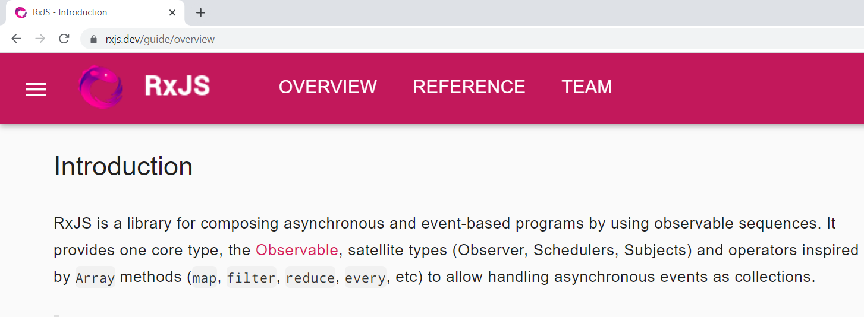
Q50. What is RxJS?
Q50
What is RxJS?
In simple words - RxJS is a javascript library, that allow us to work with asynchronous data stream with the help of observables.
Observables are introduced by RxJS library.
RxJS stands for Reactive Extensions for JavaScript.
Observable
Observer
Stream of Data
Subscriber
Back to chapter index

Slide 92
Q51. What is Observable? How to implement Observable
Q51
What is Observable? How to implement Observable?
Observables are used to stream data to multiple components.
Basically, to receive the data from API’s and continuously stream it to the multiple components.
It’s a 3 step process:
1. Import Observable from RxJS Library.
2. Create Observable & Emit Data.
3. Finally subscribe the Data.
Back to chapter index

Slide 93
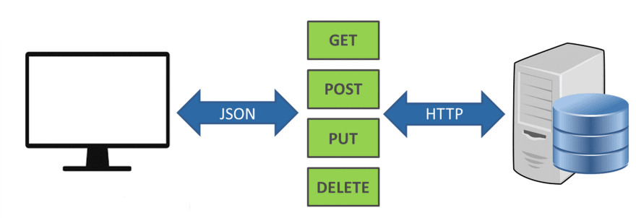
Q52. What is the role of HttpClient in Angular?
Q52
What is the role of HttpClient in Angular?
HttpClient is a built-in service class provided by Angular, which is used to perform HTTP requests(GET/POST/PUT/DELETE) to send and receive data from API or Servers.
Package name is - @angular/common/http package
Back to chapter index

Slide 94

Q53. What are the steps for fetching the data with HttpClient & Observable?
Q53
What are the steps for fetching the data with HttpClient & Observable?
3 Steps to fetch data with HTTPClient & Observables:
Suppose we want to fetch a list of students from API.
Create a service and configure observable and HTTPClient to receive the data from the API.
In the component class file, use Subscribe method to receive the data sent by the observable.
Finally in component HTML file, use the for loop to iterate and display the data list.
1. Service.ts
(Observable, HTTPClient)
2. Component1.ts
(Subscribe)
2. Component1.ts
(Subscribe)
3. Component1.html
(*ngFor)
3. Component1.html
(*ngFor)
Back to chapter index

Slide 95
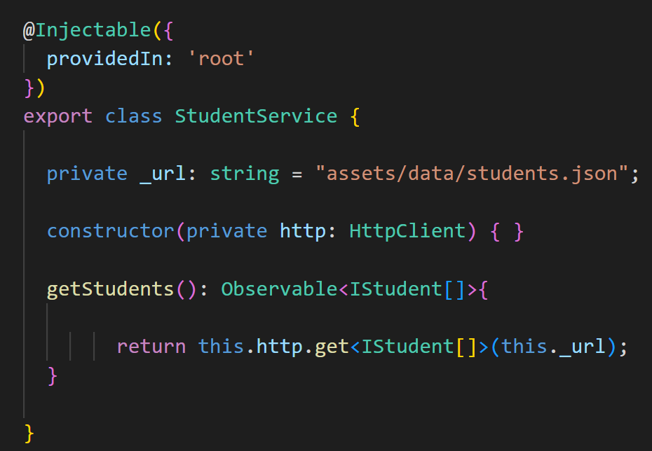
Q53
What are the steps for fetching the data with HttpClient & Observable?
1. Create a service and configure observable and HTTPClient to receive the data from the API.
Back to chapter index

Slide 96
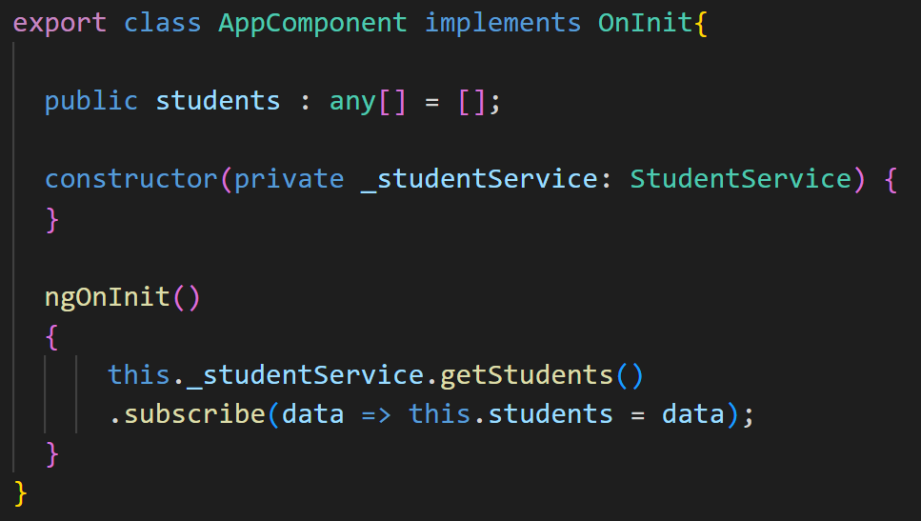
Q53
What are the steps for fetching the data with HttpClient & Observable?
2. In the component class file, use Subscribe method to receive the data sent by the observable.
Back to chapter index

Slide 97
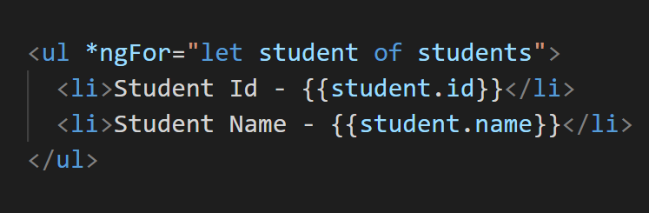
Q53
What are the steps for fetching the data with HttpClient & Observable?
2. Finally in component HTML file, use the for loop to iterate and display the data list.
Back to chapter index

Slide 98
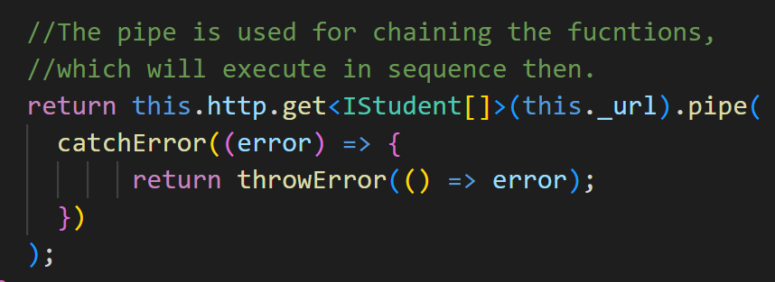
Q54. How to do HTTP Error Handling in Angular?
Q54
How to do HTTP Error Handling in Angular?
HTTP Error Handling can be done by using catchError and throwError functions from rxjs.
Back to chapter index

Slide 99
Chapter 10:
Typescript-Basics
Q55. What is Typescript? Or What is the difference between Typescript and Javascript?
Q56. How to install Typescript and check version?
Q57. What is the difference between let and var keyword?
Q58. What is Type annotation?
Q59. What are Built in/ Primitive and User-Defined/ Non-primitive Types in Typescript?
Q60. What is “any” type in Typescript?
Q61. What is Enum type in Typescript?
Q62. What is the difference between void and never types in Typescript?
Q63. What is Type Assertion in Typescript?
Q64. What are Arrow Functions in Typescript?
TOP 100
ANGULAR INTERVIEW QUESTIONS
Back to main index

Slide 100
Q55. What is Typescript? Or What is the difference between Typescript and Javascript?
Q55
What is Typescript? What are the advantages of Typescript over Javascript?
Typescript is an open-source programming language. It’s advantage are:
Typescript is a strongly typed language.
Typescript is a superset of JavaScript.
It has Object oriented features.
Detect error at compile time.
In image, you can see TS(Typescript) contains JS(Javascript) and other additional features(type system, custom types, generics, enums, interfaces).
Browser can’t execute typescript, so finally TS Compiler will convert the TS to JS only, which browser can understand.
Back to chapter index

Slide 101
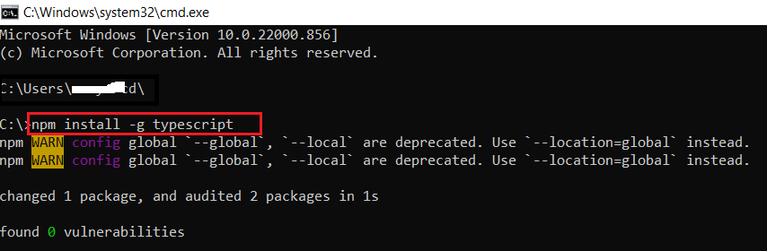
Q56. How to install Typescript and check version?
Q56
How to install Typescript and check version?
Here is the command which can be used to install typescript on your system(without Angular).
Back to chapter index

Slide 102
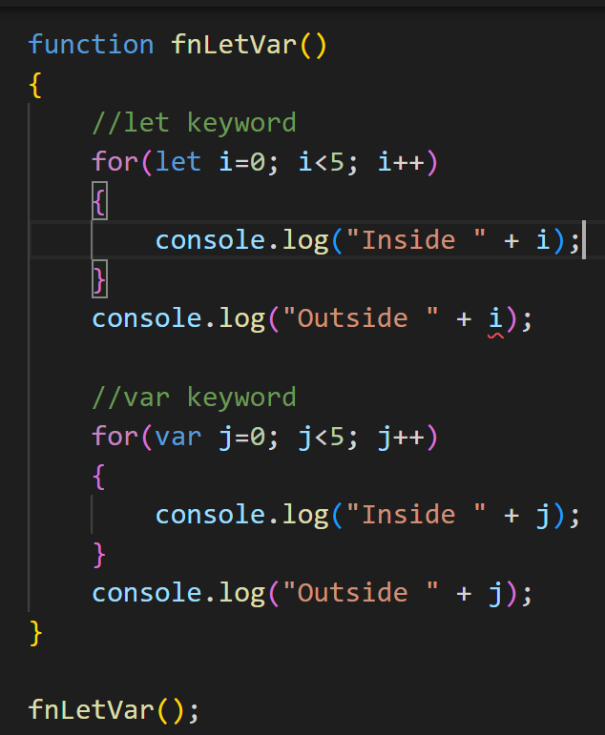
Q57. What is the difference between let and var keyword?
Q57
What is the difference between let and var keyword?
var and let are both used for variable declaration, but the difference between them is that var is global function scoped and let is block scoped.
Compile time error, since let variable “i” scope is only limited inside for loop.
No error, since var variable “j” scope is not limited inside for loop, but inside the whole function fnLetVar().
Back to chapter index

Slide 103
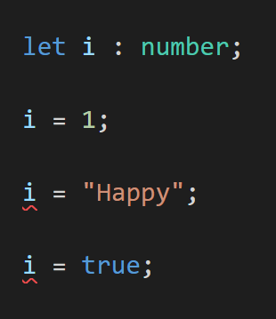
Q58. What is Type annotation?
Q58
What is Type annotation in Typescript?
Type annotations helps the compiler in checking the types of variable and avoid errors.
For example, in below image when we set variable “i” as number. And now if you assign “i” a string or Boolean value, then Typescript will show the compile time error, which is good.
Back to chapter index

Slide 104
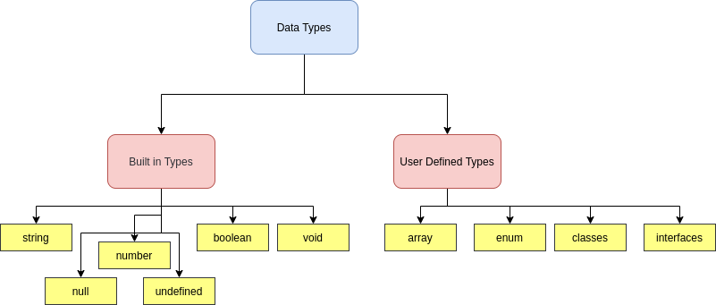
Q59. What are Built in/ Primitive and User-Defined/ Non-primitive Types in Typescript?
Q59
What are Built in/ Primitive and User-Defined/ Non-primitive Types in Typescript?
Built-in Data types are used to store simple data. Such as string, number, Boolean.
User-Defined types are used to store complex data. Such as array, enum, classes.
Back to chapter index

Slide 105
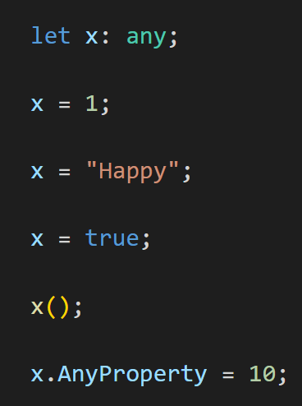
Q60. What is “any” type in Typescript?
Q60
What is “any” type in Typescript?
When a value is of type any, then no typechecking(no compile time errror) will be done by compiler and the flexibility is there to do anything with this variable.
For example, see in the image there is no compile time error for assigning different types to variable “x” because it is of any type.
Back to chapter index

Slide 106


Q61. What is Enum type in Typescript?
Q61
What is Enum type in Typescript?
Enums allows to define a set of named constants.
Suppose you have a family of constants(Directions) like this in image.
Now if you want to insert some direction, for example SouthWest between 1 and 2, then it will be a problem, as you have to change this in all of your application.
So here enum is a better way as you don’t have to assign the numbers then.
Back to chapter index

Slide 107


Q62. What is the difference between void and never types in Typescript?
Q62
What is the difference between void and never types in Typescript?
void means no type. It is used when the function will return empty.
In image, fnVoid() function will return empty.
never means it will return never. It is used to throw error only.
For example, in image fnNever function which will not reach to its last line, and it always throws an exception.
Back to chapter index

Slide 108

Q63. What is Type Assertion in Typescript?
Q63
What is Type Assertion in Typescript?
Type assertion is a technique that informs the compiler about the type of a variable.
For example, in below image, if we do not put <String>, then typescript will try to assume the type of “secondname” by itself automatically.
But by putting <String>, we are asserting and informing the compiler about the type of secondName as String and now compiler will not do automatic typechecking.
Back to chapter index

Slide 109

Q64. What are Arrow Functions in Typescript?
Q64
What are Arrow Functions in Typescript?
An arrow function expression is a compact alternative to a traditional function expression.
In below image, you can see how the same function can be written using arrow function.
Back to chapter index

Slide 110
Chapter 11:
Typescript - OOPS
Q65. What is Object Oriented Programming in Typescript?
Q66. What are Classes and Objects in Typescript?
Q67. What is Constructor?
Q68. What are Access Modifiers in Typescript?
Q69. What is Encapsulation in Typescript?
Q70. What is Inheritance in Typescript?
Q71. What is Polymorphism in Typescript?
Q72. What is Interface in Typescript?
Q73. What's the difference between extends and implements in TypeScript
Q74. Is Multiple Inheritance possible in Typescript?
TOP 100
ANGULAR INTERVIEW QUESTIONS
Back to main index

Slide 111
Q65. What is Object Oriented Programming in Typescript?
Q65
What is Object Oriented Programming(OOPS) in Typescript?
Object oriented programming is used to design structured and better applications.
In the image, you can see the concepts used in object oriented programming.
OOPS
Classes & Objects
Encapsulation
(Data Security)
Inheritance
(Code Reusability)
Polymorphism
(Multiple Forms)
Abstraction
(Hide Complexity)
Back to chapter index

Slide 112

Q66. What are Classes and Objects in Typescript?
Q66
What are Classes and Objects in Typescript?
Classes are blueprint for individual objects.
Objects are instances of a class.
Person is a class with two properties(name, age) and one method(familyCount)
objPerson is the object/instance of Person class. By this object only we can set Person class properties and call the method of the class.
Back to chapter index

Slide 113
Q67. What is Constructor?
Q67
What is a Constructor in Angular?
The constructor is a method in a TypeScript class that automatically gets called when the class is being instantiated.
Constructor always run before any angular hook and it is not a part of Lifecycle Hooks.
Constructor is widely used to inject dependencies(services) into the component class.
Back to chapter index

Slide 114
Q68. What are Access Modifiers in Typescript?
Q68
What are Access Modifiers in Typescript?
Access Modifiers
public
private
protected
3 types of Access modifiers in Typescript:
The public modifier allows class varibale, properties and methods to be accessible from all locations.
The private modifier limits the visibility to the same-class only.
The protected modifier allows properties and methods of a class to be accessible within same class and within subclasses/derived/child.
Back to chapter index

Slide 115

Q69
What are Access Modifiers in Typescript?
1. empId no error, as it is public.
2. empName error, as it is out of the class and it is private.
3. empAge error, as it is out of the class and it is protected.
3. But in PermanentEmployee empAge no error, because it is inside the derived class(PermanentEmployee) of Employee.
Back to chapter index

Slide 116

Q69. What is Encapsulation in Typescript?
Q70
What is Encapsulation in Typescript?
Encapsulation is the wrapping up of data and function together to access the data.
For example, here in code _empId is the data. We can make it public and then it can be accessible outside the Employee class.
But as per OOPS concept encapsulation this is wrong as it can lead to data security issues.
Therefore, we should mark this _empId data as private. And then create a function(getEmpId), which will help in accessing this _empId outside of this class.
Outside the class, in the last line we are calling getEmpId method to access/dispaly the data _empId.
What is the advantage of Encapsulation?
This is good for data security to prevent direct data access.
Back to chapter index

Slide 117
Q70. What is Inheritance in Typescript?
Q71
What is Inheritance in Typescript?
Inheritance is a feature where derive class will acquire the properties and methods of base class.
For example, in the image Dog and Cat class are derived from Animal base class.
Therefore, Eat() and Sleep() methods of Animal base class will be automatically available inside Dog and Cat derived class without even writing it.
What is the advantage of Inheritance?
Inheritance is good for reusability of code. As you can write one method in base class, and then use it in multiple derived classes.
Animal
Eat()
Sleep()
Base/ Parent/ Super Class
Dog
Bark()
Cat
Meaow()
Derived/ Child/ Sub Class
Back to chapter index

Slide 118

Q71
What is Inheritance in Typescript?
Both Eat() and Bark() method are accessible via Dog class object. Eat is from the base class but.
Back to chapter index

Slide 119
Q71. What is Polymorphism in Typescript?
Q72
What is Polymorphism in Typescript?
Polymorphism means same name method can take multiple Forms.
For example, in the image Son can inherit the GetSurName() method implementation of father. But the GetName() method implementation should be different for son. So son can have a different implementation but the method name can be same as GetName().
What is the advantage of Polymorphism?
Like in dictionary, a word “Running” can have multiple meanings: Running a race or Running a computer.
Similarly in programming, Polymorphism can be used to do multiple things with the same name.
Father
GetName()
GetSurName()
Base/ Parent/ Super Class
Son
GetName()
Derived/ Child/ Sub Class
Back to chapter index

Slide 120

Q72
What is Polymorphism in Typescript?
GetName() method of Father class object output is different, and Getname() method of Son class object output is different. Same name method taking multiple forms.
Back to chapter index

Slide 121

Q72. What is Interface in Typescript?
Q72
What is Interface and why to use them in Typescript?
An interface is a contract where methods are only declared.
What is the advantage of creating Interface?
For example, we have multiple classes PermanentEmployee, ContractEmployee etc.
They all must have the Role() method, but the body of Role() method can be different.
Now to maintain consistency we will create the Interface IEmployee, with just declaration of Role() method and implement this interface in all the classes.
This will make sure all the Employees classes are in sync with the Role method. It will also help in unit testing.
One advantage is, multiple inheritance can be achieved via interfaces only.
Also, if we create interfaces for the classes in application then unit testing is very easy, otherwise it is difficult.
Back to chapter index

Slide 122


Q73. What's the difference between extends and implements in TypeScript
Q73
What's the difference between extends and implements?
Extends used for base class inheritance.
Implements used for interface inheritance.
Back to chapter index

Slide 123


Q74. Is Multiple Inheritance possible in Typescript?
Q74
Is Multiple Inheritance possible in Typescript?
Multiple inheritance means when one derived class is inherited from multiple base classes.
Multiple inheritance in typescript only possible via Interfaces.
See in first image there is the compile time error in Employee2 as multiple base classes are not allowed, but in second image with multiple interfaces iit is working.
Back to chapter index

Slide 124
Chapter 12:
Angular Forms
Q75. What are Angular Forms? What are the type of Angular Forms?
Q76. What is the difference between Template Driven Forms & Reactive Forms?
Q77. How to setup Template Driven Forms?
Q78. How to apply Required field validation in template driven forms?
Q79. What is Form Group and Form Control in Angular?
Q80. How to setup Reactive Forms?
Q81. How to do validations in reactive forms?
TOP 100
ANGULAR INTERVIEW QUESTIONS
Back to main index

Slide 125

Q75. What are Angular Forms? What are the type of Angular Forms?
Q75
What are Angular Forms? What are the types of Angular Forms?
Angular forms are used to handle user's input.
For example, login form, registration form, feedback form, update profile form etc etc.
All these are forms, in which user will input and then submit the information.
Back to chapter index

Slide 126
Q75
What are Angular Forms? What are the types of Angular Forms?
4 steps data flow process in Angular forms-
The user will input the data in the HTML template file. .
Then data will be bind in the component typescript class file.
Then it will be sent to the Angular service.
Angular service will then finally send it to the Server which will receive the data and process the data. (In most cases this server will be an API only.)
1. HTML Template
2. Class (.ts)
3. Service
4. Server (API)
Collect User Data
Bind Data
Send Data
Back to chapter index

Slide 127
Q75
What are Angular Forms? What are the types of Angular Forms?
There are 2 types of forms in Angular:
Template driven forms - In template driven forms, most of the code will be written and handled in HTML templates only.
Reactive forms - in reactive forms most of the code will be written in component typescript class file.
Types of Forms
Template Driven Forms
Reactive Forms
Back to chapter index

Slide 128
Q76. What is the difference between Template Driven Forms & Reactive Forms?
Q76
What is the difference between Template Driven Forms & Reactive Forms?
Template Driven Forms
Reactive Forms
1. Most code and validation logic is
Most code and validation logic is written
written in
HTML template
.
in
component typescript
class file.
2. Have to add
FormsModule
in
Have to add
ReactiveFormsModule
in
AppModule
to activate it.
AppModule
to activate it.
3. Used when application is simple and
Used when application is complex and
have
less controls
.
have
more controls
.
Back to chapter index

Slide 129

Q77. How to setup Template Driven Forms?
Q77
How to setup Template Driven Forms?
Below is the sample code to setup login form using template driven form approach in html template file. Here we have used template reference variable (#loginForm).
Back to chapter index

Slide 130
Q78. How to apply Required field validation in template driven forms?
Q78
How to apply Required field validation in template driven forms?
For example, if you want to put required field validation in email field, then put the required keyword there, which will make the form invalid until the email is empty. Also, you can disable the button if the form is invalid.
Back to chapter index

Slide 131

Q79. What is Form Group and Form Control in Angular?
Q79
What is Form Group and Form Control in Angular?
Form controls are the individual elements.
Form groups is a collection of form controls.
Form Controls
Form Group
Back to chapter index

Slide 132
Q79. What is Form Group and Form Control in Angular?
Q79
What is Form Group and Form Control in Angular?
What is the use of FormGroup and FormControl?
Both FormGroup and FormControl are used to track the values and states of controls.
In image you can see, both formgroup and formcontrol are inherited from AbstractControl class. AbstractControl class has these properties -Value, errors, valid, invalid, dirty, pristing, touched and touched.
Now these properties will help in tracking the changes in each and every control. For example, value property will be the value of any input field.
That’s why FormGroup and FormControl are required to keep track of the changes in the controls.
value
errors
valid
invalid
dirty
pristine
touched
untouched
AbstractControl
FormGroup
FormControl
Properties
Back to chapter index

Slide 133
Q80. How to setup Reactive Forms?
Q80
How to setup Reactive Forms?
Below are some important points about Reactive Forms:
In reactive forms most code and validation logic is written in component typescript file.
Reactive Forms can be activated by adding ReactiveFormsModule in AppModule.
When to use Reactive forms and when to use template driven forms?
Reactive Forms are used when application is complex and have more number of controls.
Template driven forms is used when number of controls are very less in the form.
Normally we prefer reactive forms in general.
Back to chapter index

Slide 134

Q80
How to setup Reactive Forms?
Back to chapter index

Slide 135

Q81. How to do validations in reactive forms?
Q81
How to do validation in reactive forms?
Back to chapter index

Slide 136
Chapter 13:
Authentication/ JWT/ Auth Gurad/ HTTP Interceptor
Q82. What is Authentication & Authorization in Angular?
Q83. What is JWT Token Authentication in Angular?
Q84. How to Mock or Fake an API for JWT Authentication?
Q85. How to implement the Authentication with JWT in Angular?
Q86. What is Auth Guard?
Q87. What is HTTP Interceptor?
Q88. How to Retry automatically if there is an error response from API?
Q89. What are the parts of JWT Token?
Q90. What is Postman?
Q91. Which part of the request has the token stored when sending to API?
TOP 100
ANGULAR INTERVIEW QUESTIONS
Back to main index

Slide 137


Q82. What is Authentication & Authorization in Angular?
Q82
What is Authentication & Authorization in Angular?
Authentication is the process to verify the user’s identity.
Authorization is the process of allowing a user to access the resources as per the role.
Authentication is always done before Authorization.
Back to chapter index

Slide 138
Q83. What is JWT Token Authentication in Angular?
Q83
What is Token(JWT) Authentication Process in Angular?
JWT authentication is a process to authenticate Angular user credentials to get or post data from API’s.
Upcoming is the image, where we will see, how the request will start from Angular and what are the steps to authenticate the request and get the data back from the API.
Back to chapter index

Slide 139






Q83
What is Token(JWT) Authentication Process in Angular?
Front-end/ Client-side
Middleware/ Server-side/ Backend
1. POST: {username, password}
2. Authenticate &
create JWT Token
3. Return Response {JWT token}
4. Store JWT token at local storage
5. Request Data {JWT token: Header}
6. Validate token signature
7. Send Data
Back to chapter index

Slide 140
Q84. How to Mock or Fake an API for JWT Authentication?
Q84
How to Mock or Fake an API for JWT Authentication?
Angular developer need not to develop the API. This question is better explained in the video.
Back to chapter index

Slide 141

Q85. How to implement the Authentication with JWT in Angular?
Q85
How to implement the Authentication with JWT in Angular?
Steps to implement JWT Authentication in Angular:
Create a reactive login form, setup email and password.
Create one SubmitLogin method and check whether login form is valid or not.
If valid, call service(AuthService) method(proceedLogin) and send the loginForm values and use subscribe method to get the result from the observable.
Store the token in local storage of browser. So that for next subsequent request, only token is sent, not the credentials again.
Back to chapter index

Slide 142

Q85
How to implement the Authentication with JWT in Angular?
5. Create Service(AuthService).
6. Inside service set API URL(apiurl)
7. Setup HTTPClient to send the request using API url.
8. Use Observalbe to receive the data or toke from the request and return it to the component.
Why we created service and have not directly written this code in component?
So that all the components can use this reusable service method.
Back to chapter index

Slide 143
Q85
How to implement the Authentication with JWT in Angular?
Here are the Angular features we have used to implement Authentication in Angular:
1. Services
2. Routing
5. Dependency Injection
3. Reactive Forms
4. HttpClientModule
6. Observable & Subscriber
Back to chapter index

Slide 144

Q86. What is Auth Guard?
Q86
What is Auth Guard or Route Guard? When to use it?
Auth guard is used for guarding the routes.
For example, in the image, suppose you are at this login url. Now without entering the username and password, by just changing the url manually, you want to go to the home component. This is not right. So, to prevent this action we use auth guards.
This guard will redirect your request to some other component which you will set in the guard or to the login component only.
http://localhost:4200/login
http://localhost:4200/home
http://localhost:4200/login
Back to chapter index

Slide 145
Q87. What is HTTP Interceptor?
Q87
What is HTTP Interceptor? When & why to use it?
Interceptor is a special Angular Service, that can be used to intercept all the request and response calls and modify them to our requirement.
For example, suppose after authentication you receive the token. Then with every request you will send the token. So, you have to add token code in every request. You can place this token code at a single place which is called HTTP interceptor. Then whenever any HTTP request will be about to sent. Then this HTTP Interceptor will add the token to the request.
http://happy.com/angular
{token}
{token}
http://happy.com/login
http://happy.com/home
{token}
http://happy.com/dotnet
{username, password}
{token}
Http Interceptor
{token}
{token}
http://happy.com/azure
Back to chapter index

Slide 146

Q87
What is HTTP Interceptor? When & why to use it?
Back to chapter index

Slide 147

Q88. How to Retry automatically if there is an error response from API?
Q88
How to Retry automatically if there is an error response from API?
Suppose your angular is requesting something from the API. But the API is down or there is some network issue. Then you want your Angular App to retry again automatically.
The answer is we will use Retry operator of RxJS library.
In image, inside the interceptor if connection fail one time, then Angular will automatically retry 3 more times to make the request.
Back to chapter index

Slide 148

Q89. What are the parts of JWT Token?
Q89
What are the parts of JWT Token?
JWT stands for JSON Web Tokens. It has 3 parts:
Header
Payload
Signature
JWT Token
Back to chapter index

Slide 149

Q90. What is Postman?
Q90
What is Postman?
Postman is a tool for testing API’s.
Back to chapter index

Slide 150

Q91. Which part of the request has the token stored when sending to API?
Q91
Which part of the request has the token stored when sending to API?
Token is sent in the HEADER part of the request.
Back to chapter index

Slide 151
Chapter 14:
Components Communication
Q92. What are the various ways to communicate between the components?
Q93. What is ContentProjection? What is <ng-content>?
Q94. What is Template Reference Variable in Angular?
Q95. What is the role of ViewChild in Angular?
Q96. How to access the child component from parent component with ViewChild?
Q97. What is the difference between ViewChild and ViewChildren? What is QueryList?
Q98. What is ContentChild?
Q99. What is the difference between ContentChild & ContentChildren?
Q100. Compare ng-Content, ViewChild, ViewChildren, ContentChild & ContentrChildren?
TOP 100
ANGULAR INTERVIEW QUESTIONS
Back to main index

Slide 152
Q92. What are the various ways to communicate between the components?
Q92
What are the various ways to communicate between the components?
When we have multiple components in a single page application. Then many a times we have to send and receive data and content(html) from one component to another component. This is called communication between components.
We also call these communicating components as parent and child components.
Parent Component
Child Component
Back to chapter index

Slide 153
Q92
What are the various ways to communicate between the components?
We already discussed @Input and @Output decorators in previous questions.
@Input decorator is used to transfer data from parent to child component.
@Output decorator is used to transfer data from child to parent component.
In upcoming questions we will discuss rest of the ways to transfer content between components.
Remember @Input and @Output is used to transfer data and rest of decorators are used to transfer content(html).
@Input
@Output
Ng-content
@ViewChild
@ViewChildren
@ContentChild
@ContentChildren
Back to chapter index

Slide 154



Q93. What is ContentProjection? What is <ng-content>?
Q93
What is Content-Projection? What is <ng-content>?
ng-content is used to insert the dynamic/variable html content from one component to another component.
For example, in the first image we have the <app-sport> selector of the child component in parent component html. And in the second image we have the html of child component app-sport.
When the page will be displayed then <ng-content> of title class in child component will be replaced by Football dynamically.
Back to chapter index

Slide 155


Q94. What is Template Reference Variable in Angular?
Q94
What is Template Reference Variable in Angular?
Template Reference Variable in angular is used to access all the properties of any element inside DOM.
For example, in mage #inputBox is the template reference variable of that input element. Then the getInput(inputBox.value) method is used to transfer the value property of the #inputBox.
That’s how we can send different properties of template reference variable to component class file.
Then in next image, we are receiving the value property in the parameter and printing it via console.log.
Back to chapter index

Slide 156


Q95. What is the role of ViewChild in Angular?
Q95
What is the role of ViewChild in Angular?
@ViewChild decorator is used to access elements of html template file from the component typescript file.
For example, in image you can see emailRef is the template reference variable in html file and it is accessed in component class via @ViewChild decorator.
Back to chapter index

Slide 157
Q95
What is the role of ViewChild in Angular?
When to use @viewchild?
When we want to access the element of html component file in the component class file of same component.
When we want to access the element of child html component file in the parent component class file.
Back to chapter index

Slide 158

Q96. How to access the child component from parent component with ViewChild?
Q96
How to access the child component from parent component with ViewChild?
To access the child component from parent component, we have to write the code inside the ngAfterViewInit lifecycle hook of the parent component class file.
Because if we will write the code in ngOnInit or any other lifecycle hook before ngAfterViewInit, then may be the child component is still not fully developed till then and this may lead to error.
Back to chapter index

Slide 159


Q97. What is the difference between ViewChild and ViewChildren? What is QueryList?
Q97
What is the difference between ViewChild and ViewChildren? What is QueryList?
@ViewChildren does the same thing as @ViewChild decorator, but @ViewChild can access only one element, but @ViewChildren can access a list of elements.
Back to chapter index

Slide 160
Q97
What is the difference between ViewChild and ViewChildren? What is QueryList?
QueryList used to manage the list of elements.
It is used with @ViewChildren to refer the list of elements of type ElementRef.
Back to chapter index

Slide 161


Q98. What is ContentChild?
Q98
What is ContentChild?
ContentChild is used to send variable or projected content from one component html to another component class file.
To access the element in child component, we have to write the code inside the ngAfterContentInit lifecycle hook of the child component class file.
Back to chapter index

Slide 162


Q99. What is the difference between ContentChild & ContentChildren?
Q99
What is the difference between ContentChild & ContentChildren?
@ContentChildren does the same thing as @ContentChild decorator, but @ContentChild can access only one element, but @ContentChildren can access a list of elements.
Back to chapter index

Slide 163
Q100. Compare ng-Content, ViewChild, ViewChildren, ContentChild & ContentrChildren?
Q100
Compare ng-Content, ViewChild, ViewChildren, ContentChild & ContentrChildren?
<ng
-
content>
@ViewChild
@ViewChildren
@ContentChild
@ContentChildren
(Content Projection)
1. Use Case
Used to display
Used to send content from:
Used same as
Used to send
Used same as
variable content
1. Same component html
@ViewChild, but in
projected content
@ContentChild, but in
from child
template
-
> Component
addition it can handle
from
component
addition it can handle
component html to
class.
multiple elements
.
HTML template file
-
>
multiple elements
.
parent component
2. Child component
-
>
Another component
html.
Parent Component class.
class file.
2. Example/
<ng
-
content
@ViewChild('emailRef')
@ViewChildren('emailRe
@ContentChild(‘email
@ContentChildren(‘emal
Declaration
select=".title"></ng
-
emailElement
:
ElementRef
f')
emailElement
:
Ref')
emailElement
:
iRef')
emailElement
:
content>
QueryList
<
ElementRef
>
ElementRef
QueryList
<
ElementRef
>
3. Template
No
Yes
Yes
Yes
Yes
reference
variable
4. Type
No type, since it’s a
ElementRef
.
QueryList
<
ElementRef
>
.
ElementRef
.
QueryList
<
ElementRef
>
html to html content
(It’s a wrapper around an
(It’s a list of
ElementRef
)
transfer.
element)
Back to chapter index

Slide 164

All the best for your interviews Never ever give up

